Slide 1
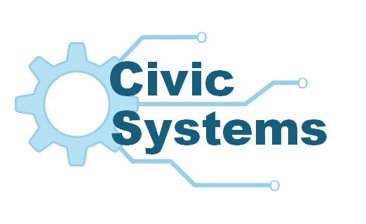
Missed Orders? Keep track using our Order Management Application

Slide 2
Team Introduction
Adil
Isaac Trevathan
Cody Ung
Calixte
Prabhu Roka
Gabe Winson
Deborah Yang

Slide 3
Outline
Client Overview
Objective Statement
Project Analysis
System Proposals
Recommended Proposal
Questions and Answers
Lessons Learned
Demonstration

Slide 4

Client Overview
Emily Bakes Cakes
Operating in Houston, Tx since 2003
Cakes, Cupcakes, Cookies and Pastries
Emily Boudreaux
Boudreaux family recipes made from scratch
European-Style Cake Customization and Decoration

Slide 5

Objective Statement
Objective: Improve revenue and customer retention by implementing a web order database application.
Context:
About 3-5 orders are lost per month
Decrease in customer satisfaction and retention.
ThePhoto by PhotoAuthor is licensed under CCYYSA.

Slide 6
Project Analysis
Project Problems
An outdated order system
An outdated customer management system
Client Problems
Lost or duplicate orders
Long order creation times
Lack of customer retention
Expected Solution
Customer and Order Web Database Application
Older Hardware/Lack of existing infrastructure
Overuse of manpower

Slide 7


System Proposals
Web Database Application Requirements
Graphic User Interface
Data Access System
Database Storage
2 System Proposals for Database System
Amazon Relational Database Service
MySQL Database Direct Connection

Slide 8


System Proposals
Proposal 1
Amazon Relational Database Service
Pay for What You Use
Scale Service For Business Needs
Automated Backups And Database Restoration

Slide 9


System Proposals
Proposal 2
My SQL Database Direct Database Connection
No Availability Issues
Low Cost
Ease of Use

Slide 10


Recommended Proposal
Civic Systems Recommended Proposal
Amazon Relational Database Service
Rationalization
Seamless Integration with Web Database Application
Cost efficient Pay-Per-Use Model
Data Security and Availability
IT Support Service

Slide 11
Web Database Application Demonstration

Slide 12
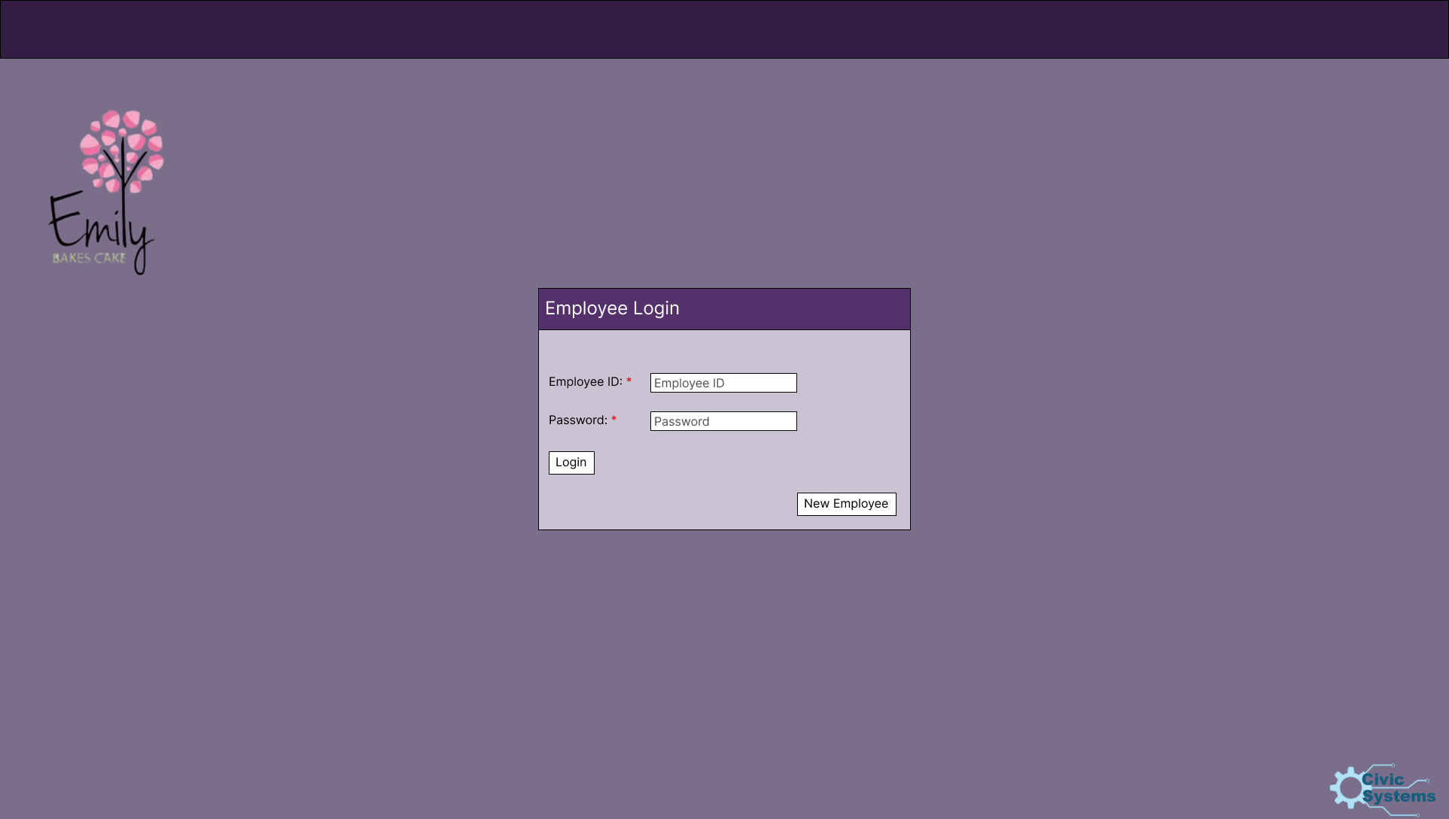

Slide 13
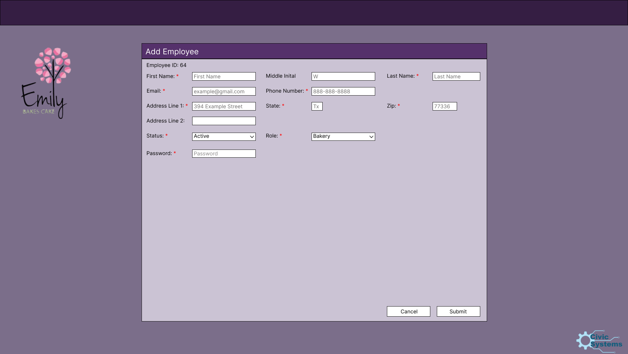

Slide 14
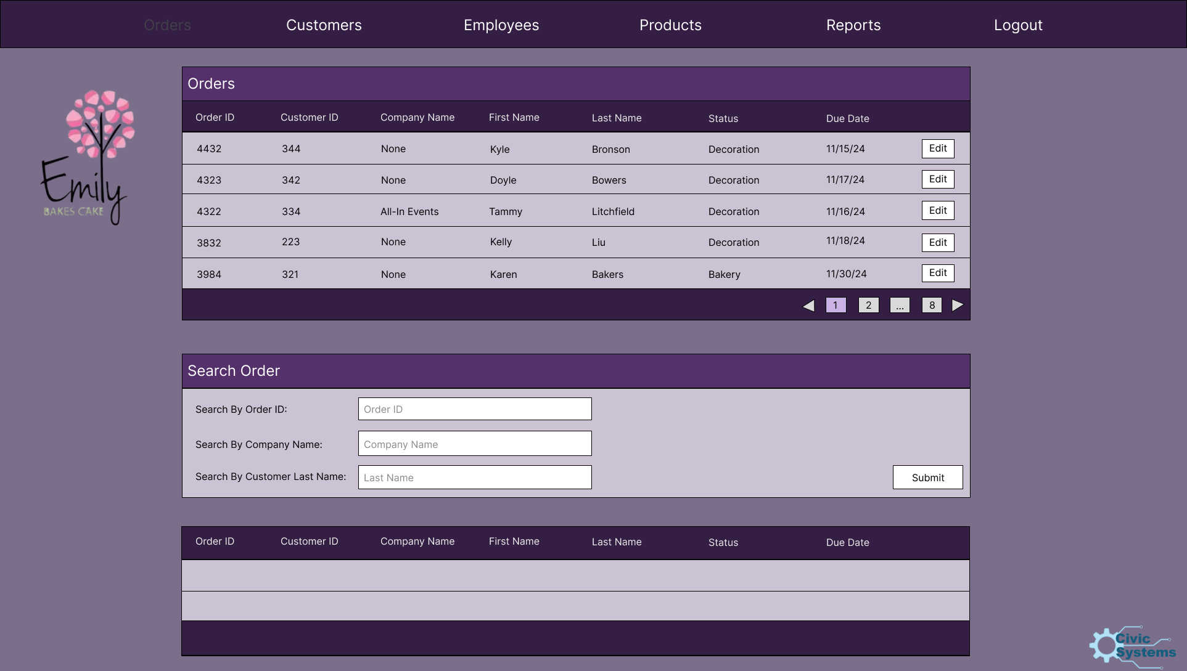

Slide 15


Slide 16
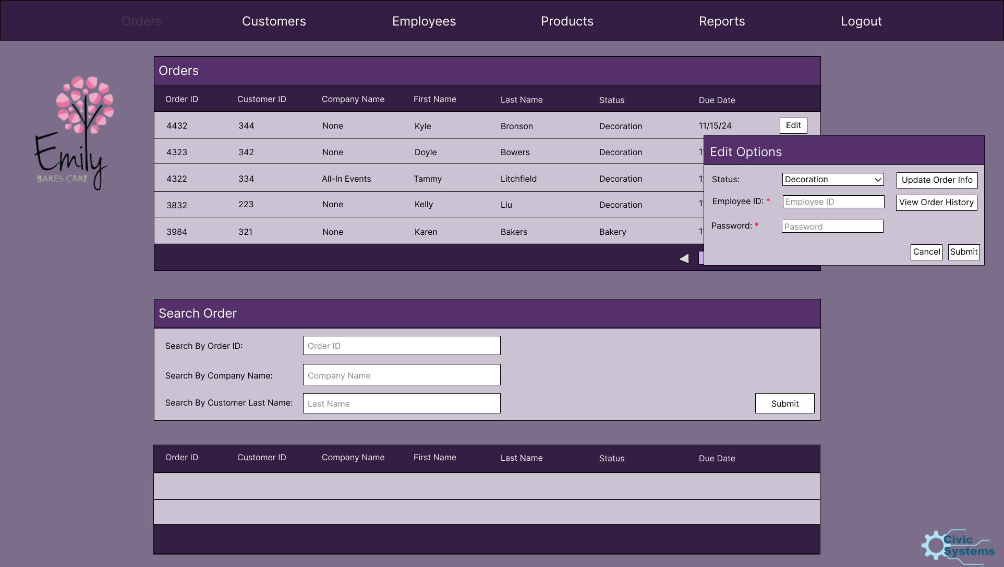

Slide 17
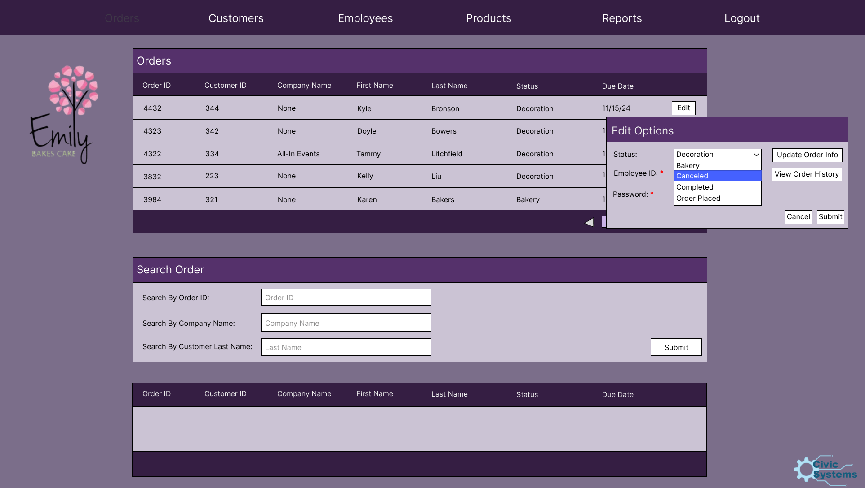

Slide 18


Slide 19
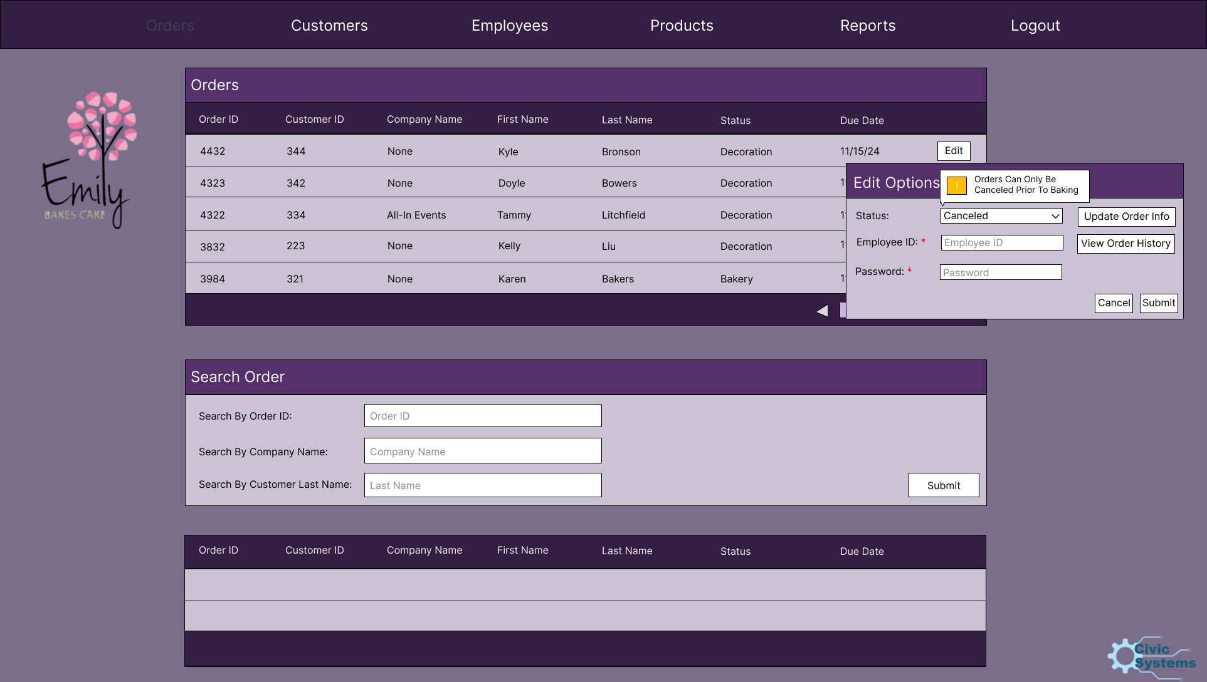

Slide 20
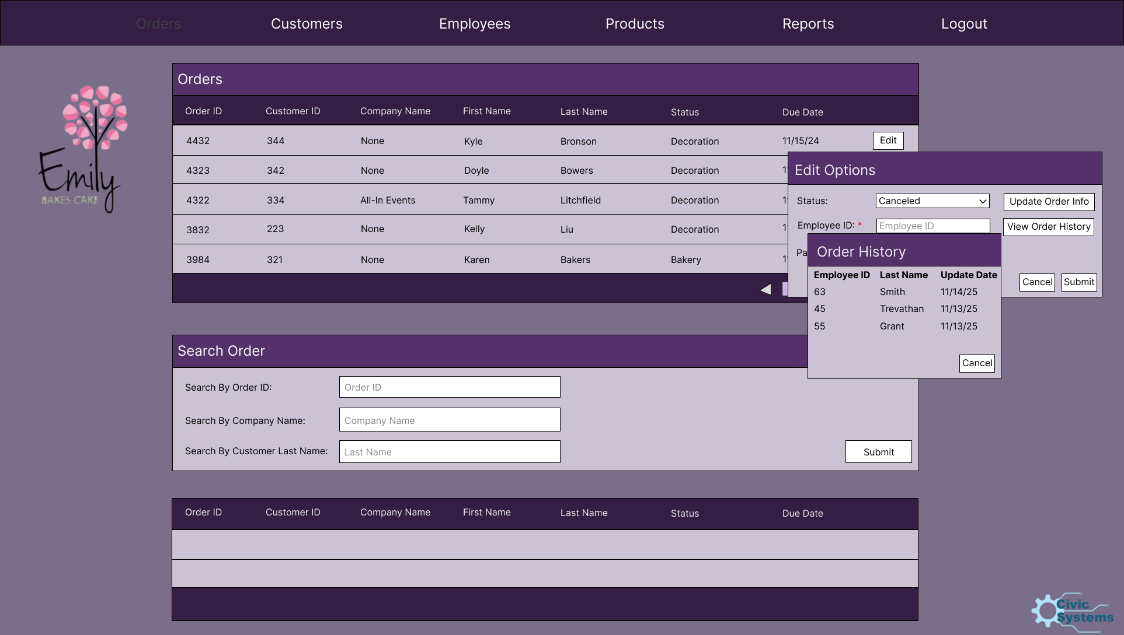

Slide 21
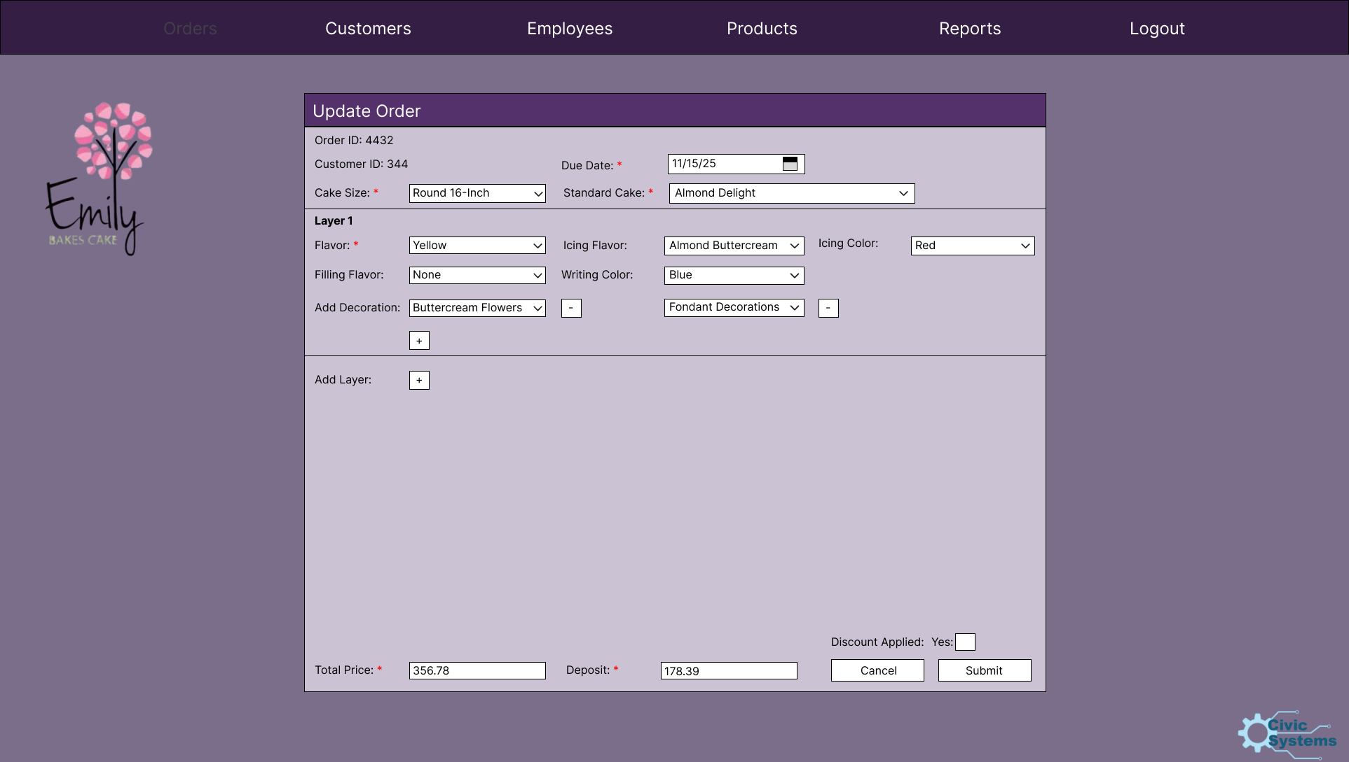

Slide 22
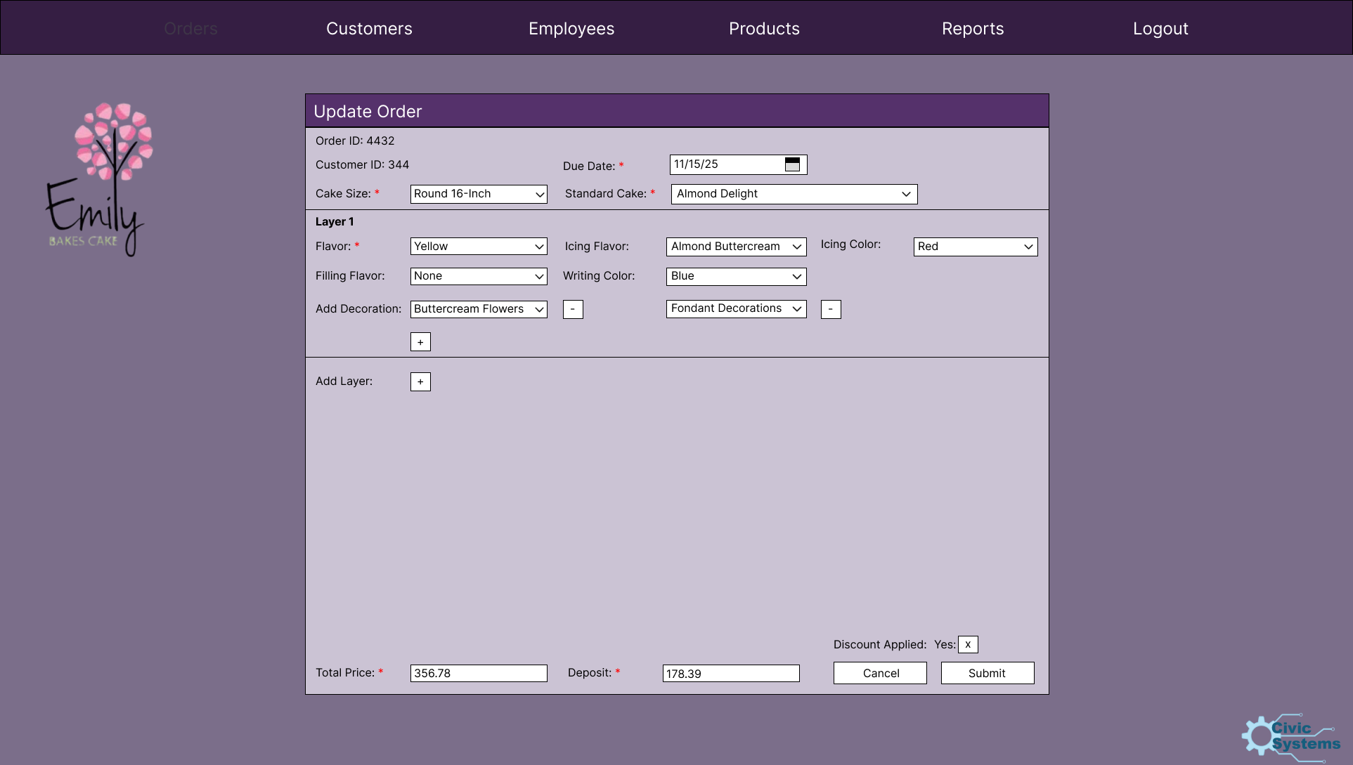

Slide 23
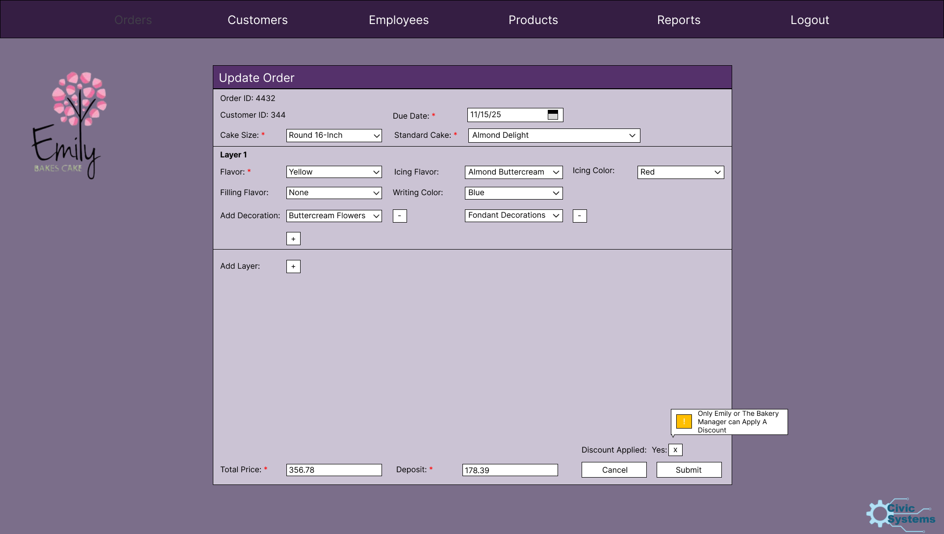

Slide 24
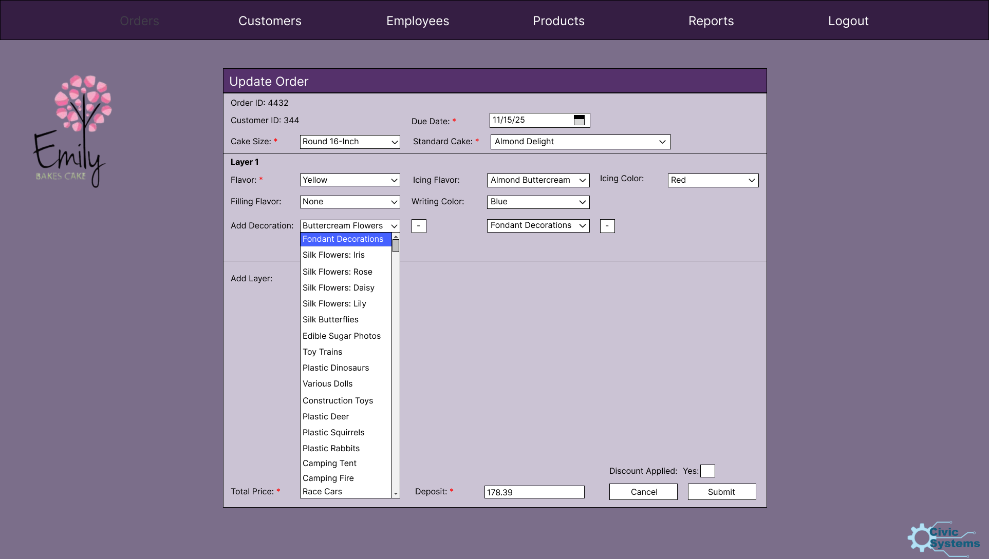

Slide 25


Slide 26
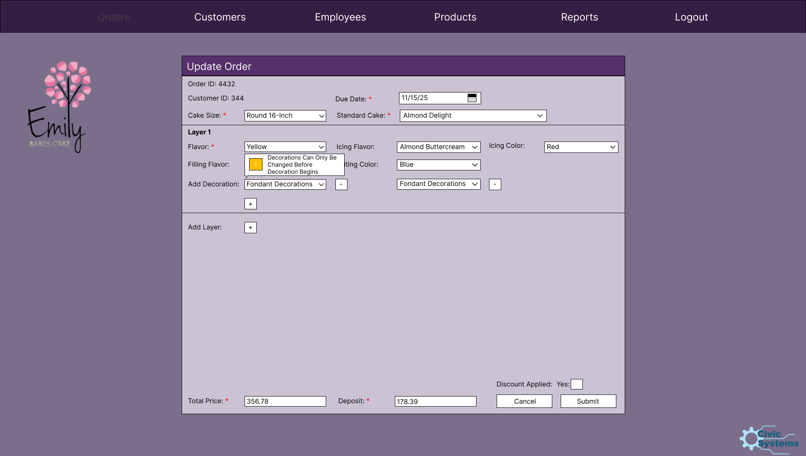

Slide 28
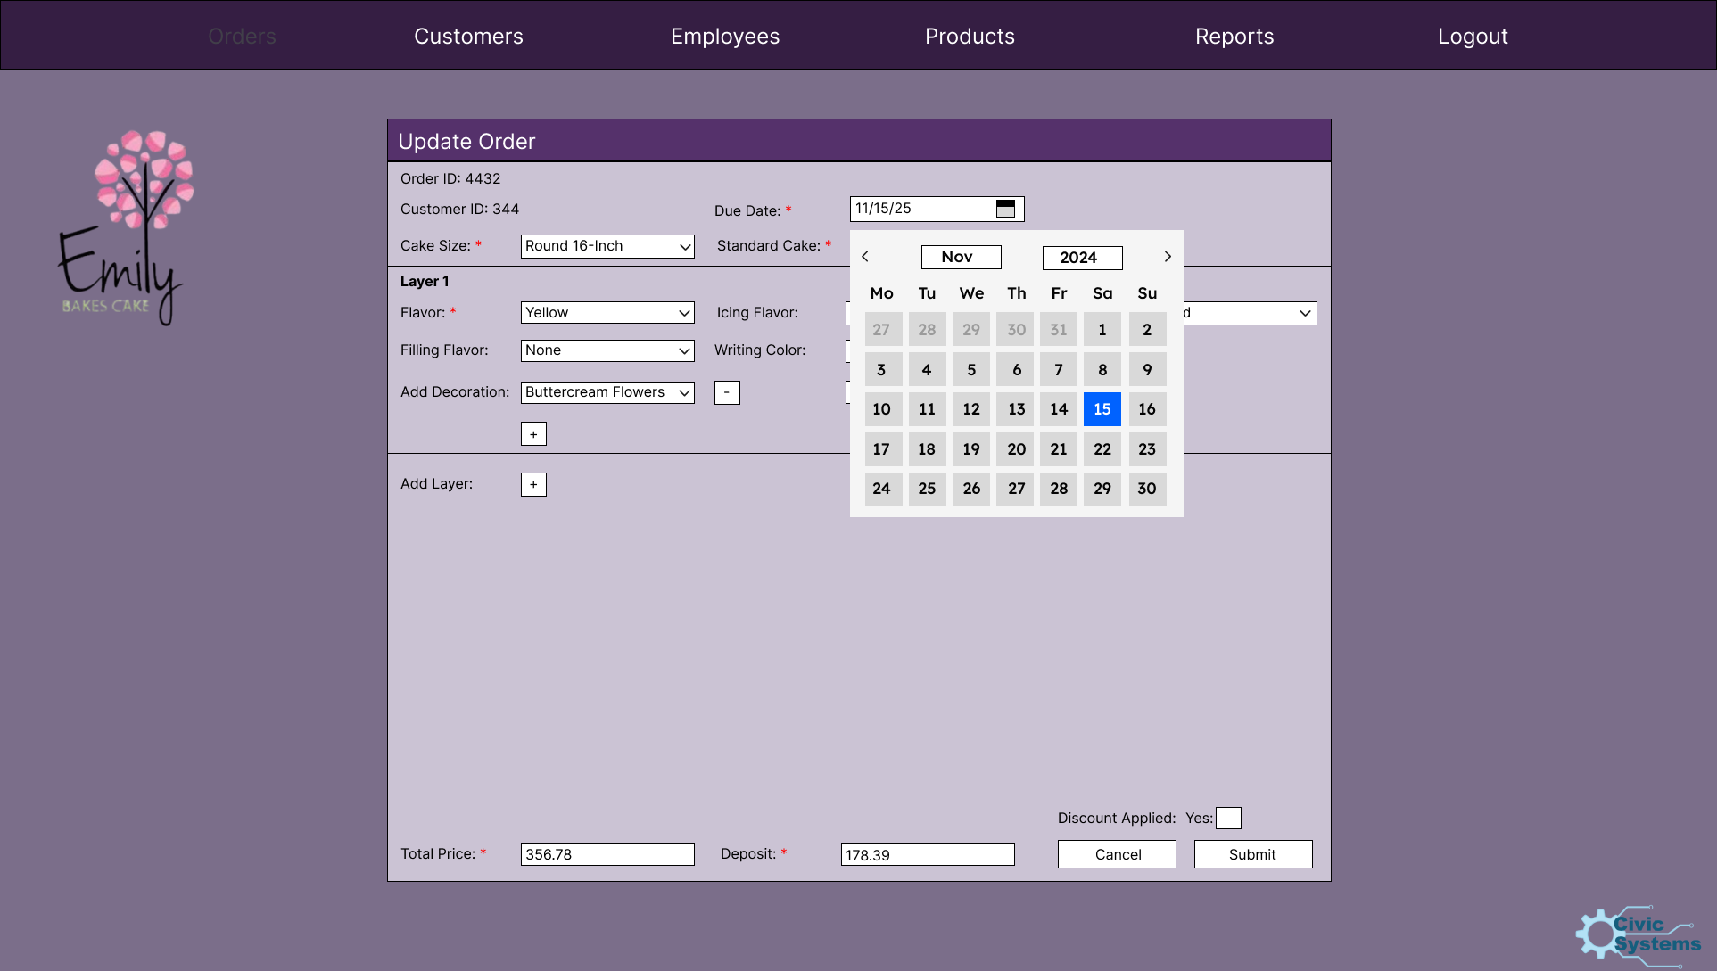

Slide 29
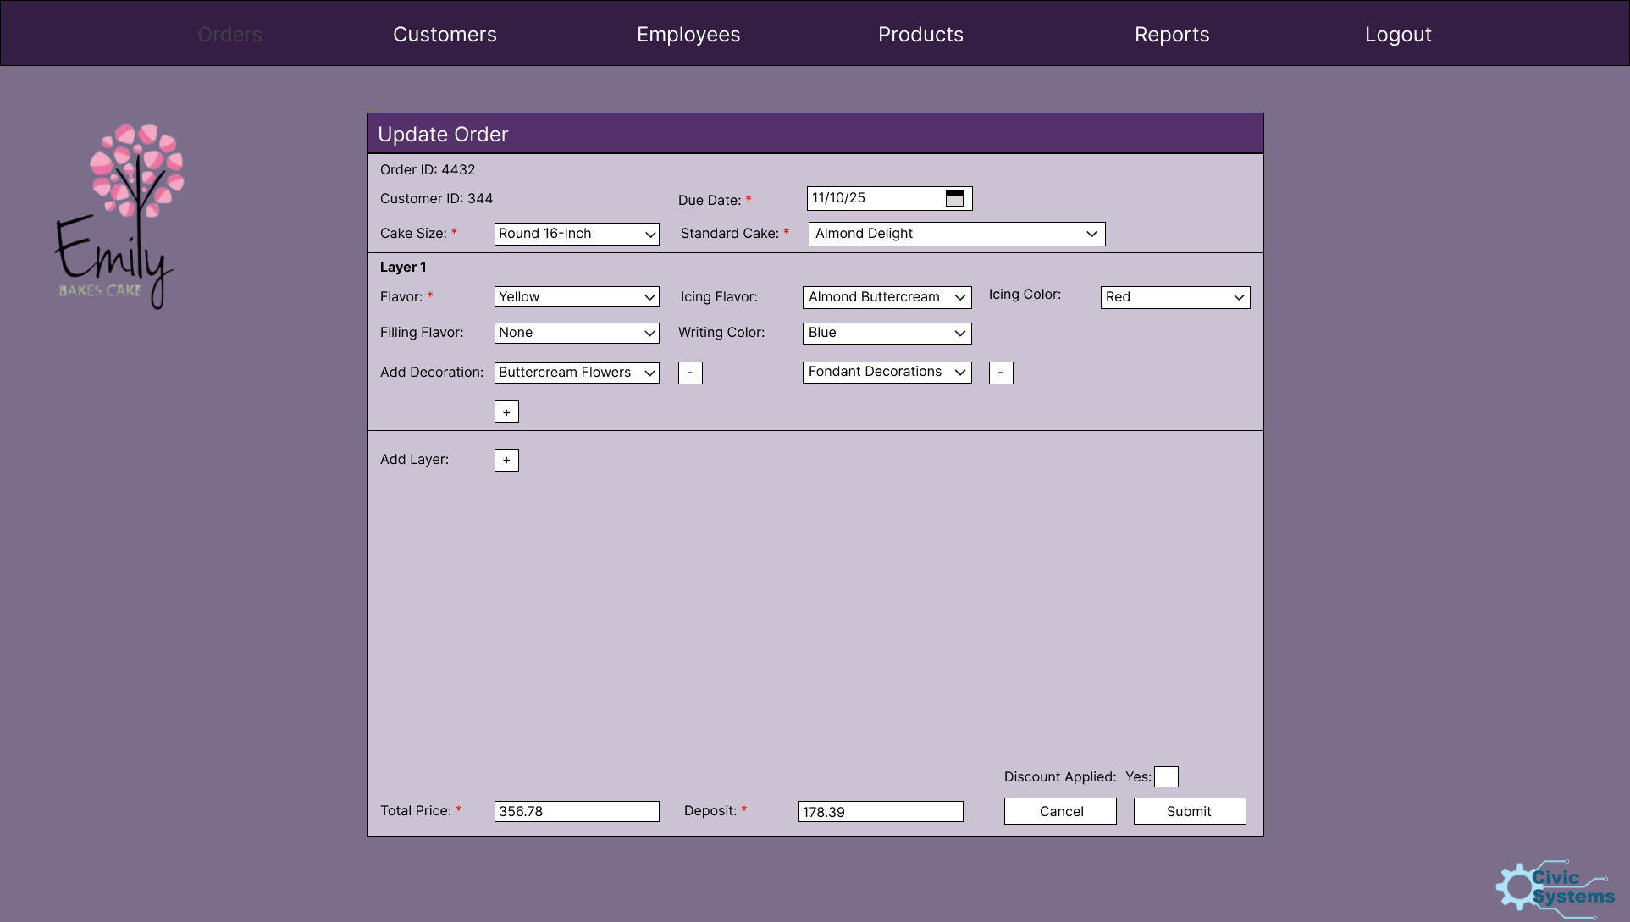

Slide 30
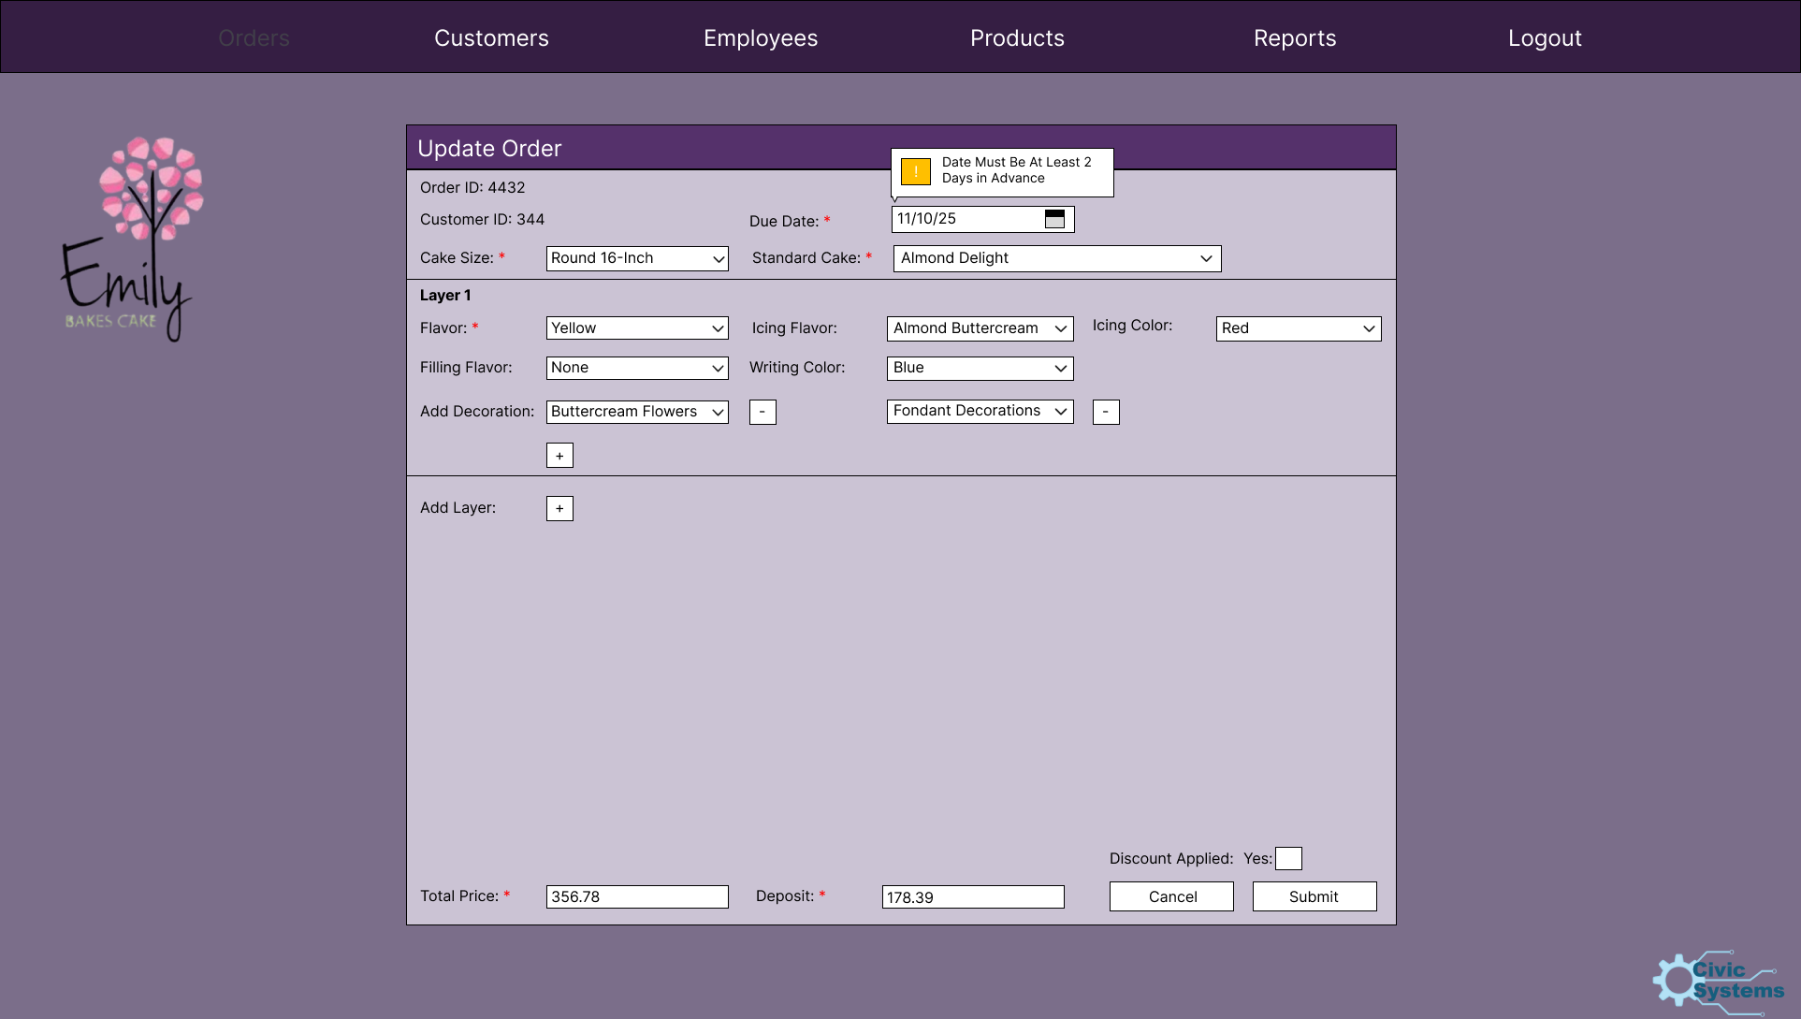

Slide 31
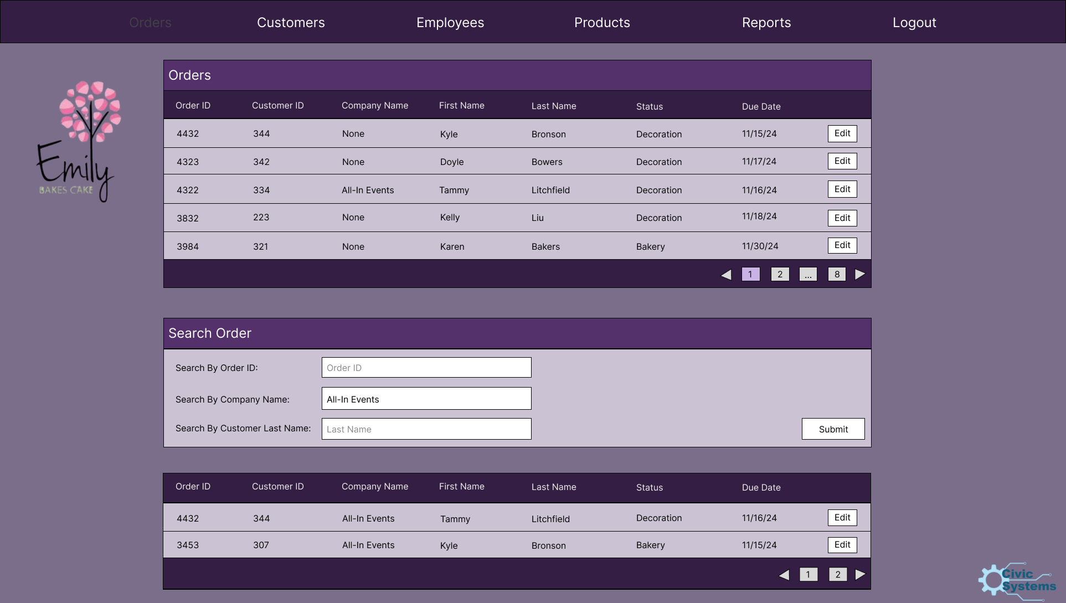

Slide 32
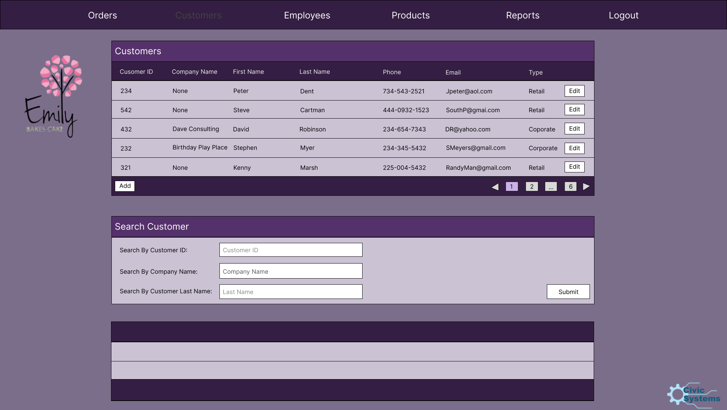

Slide 33
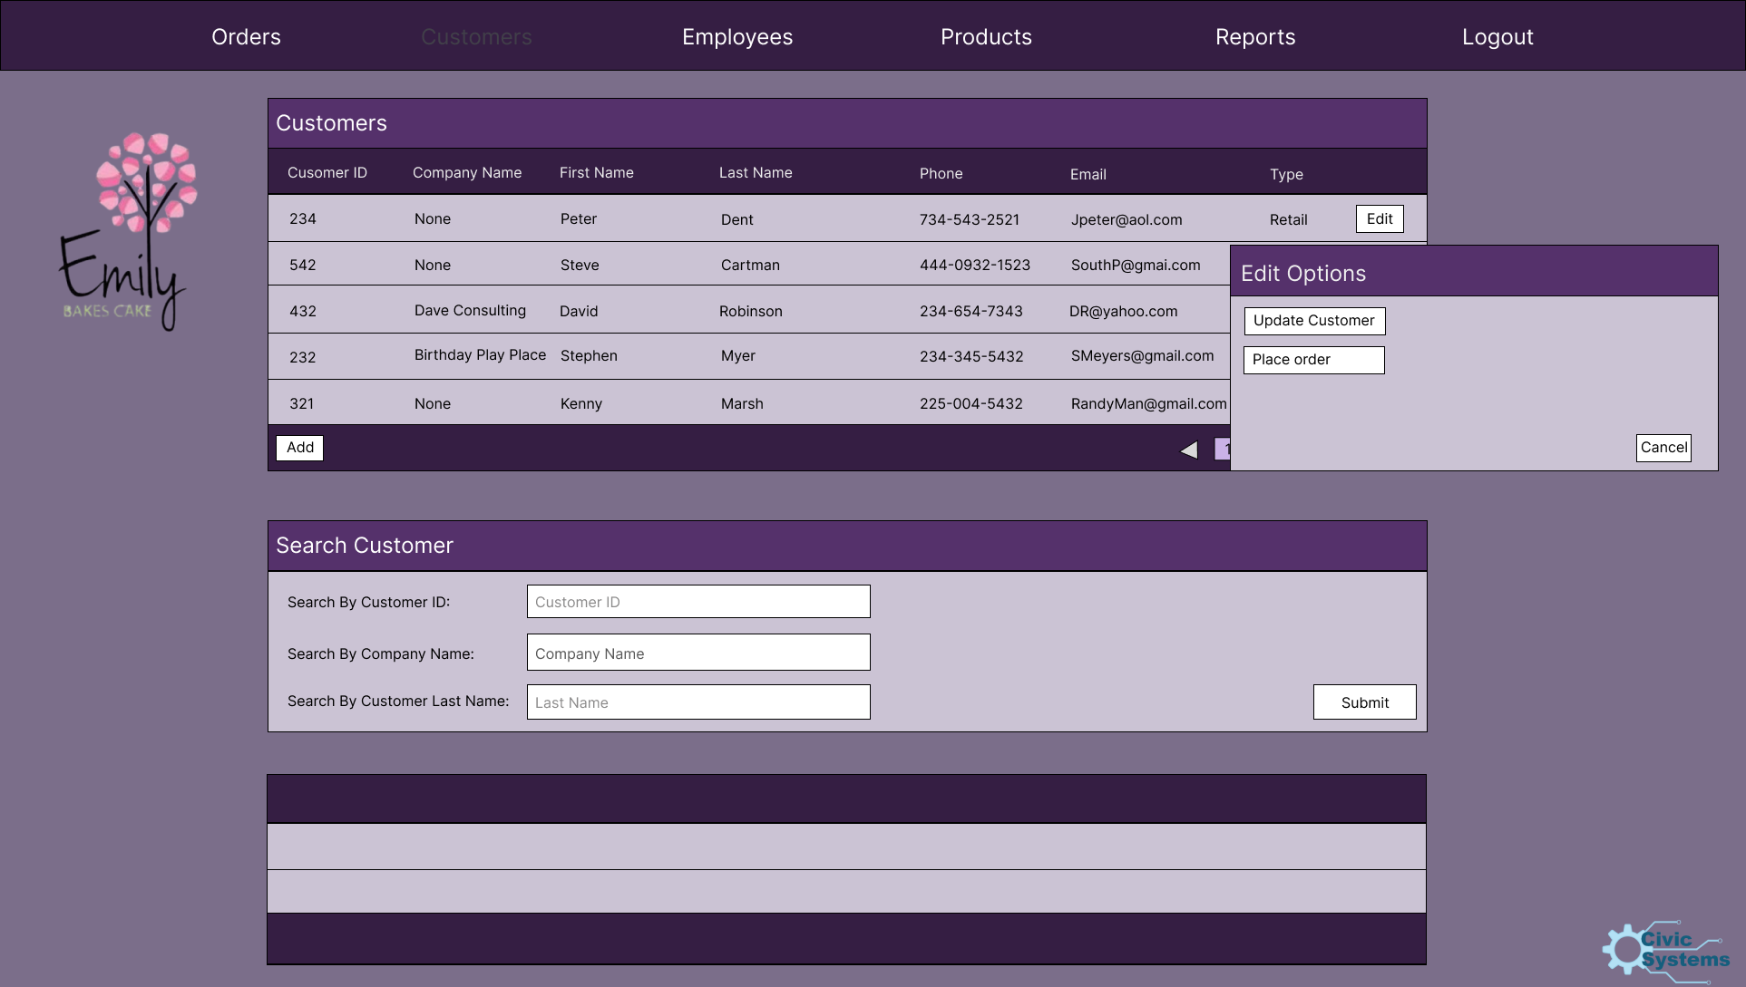

Slide 34
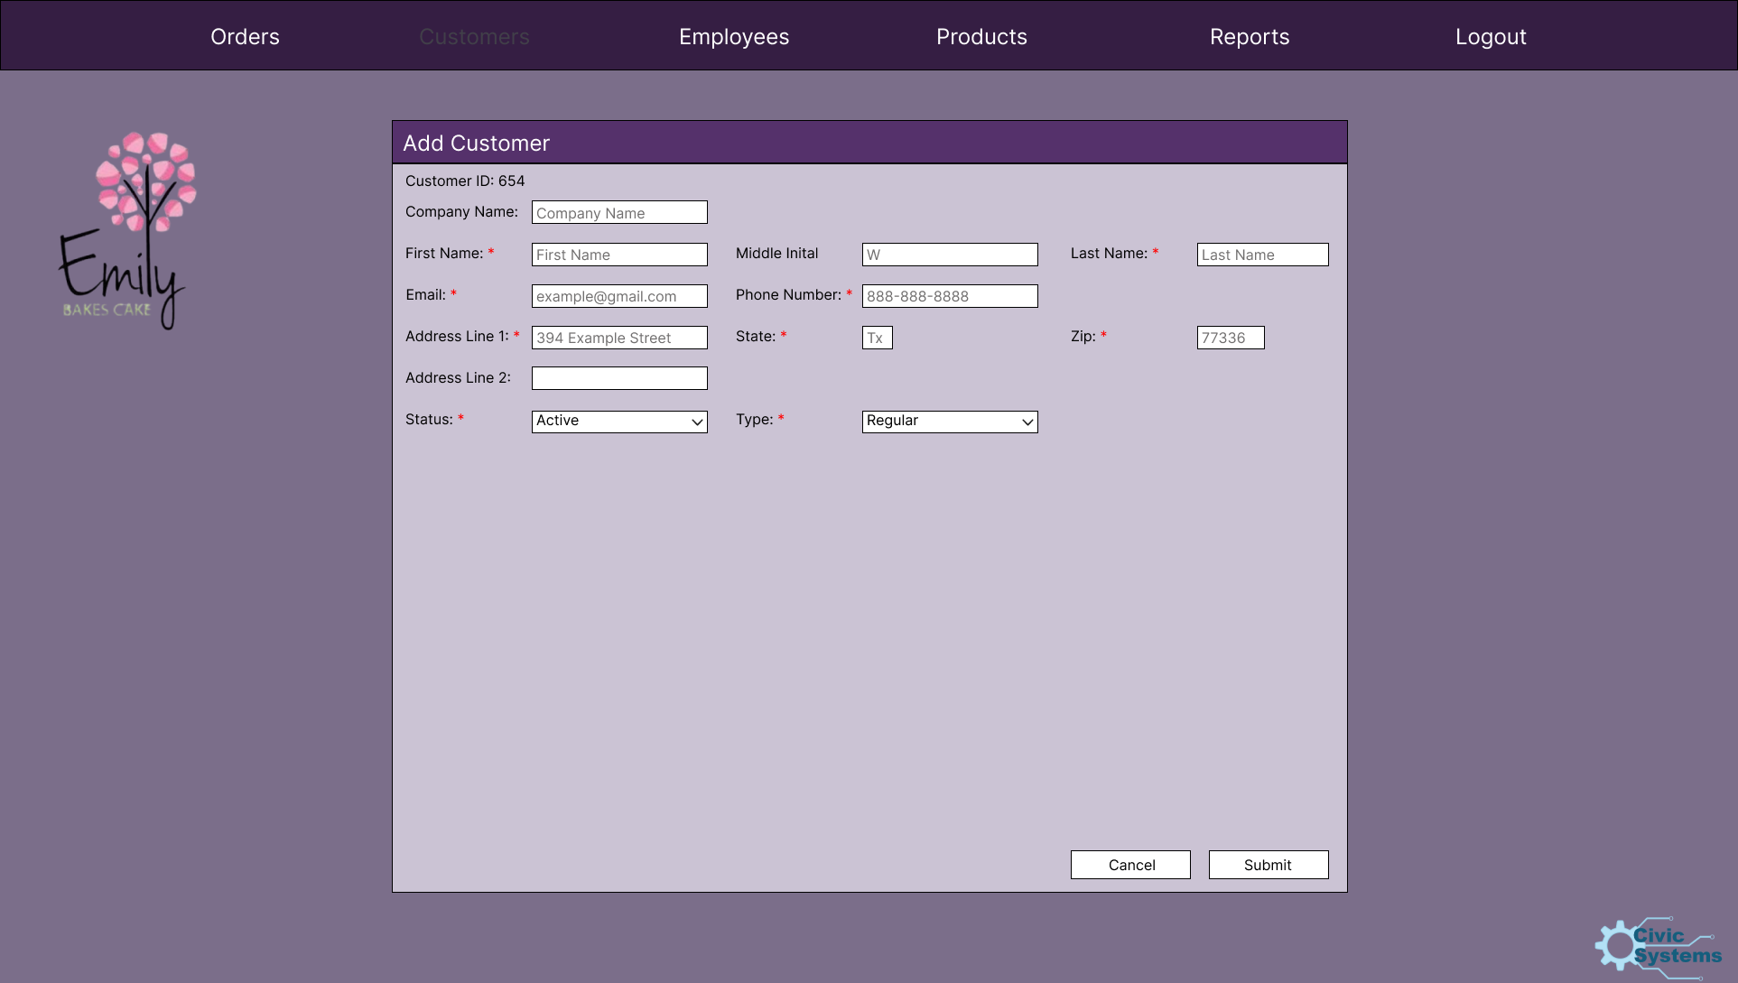

Slide 35
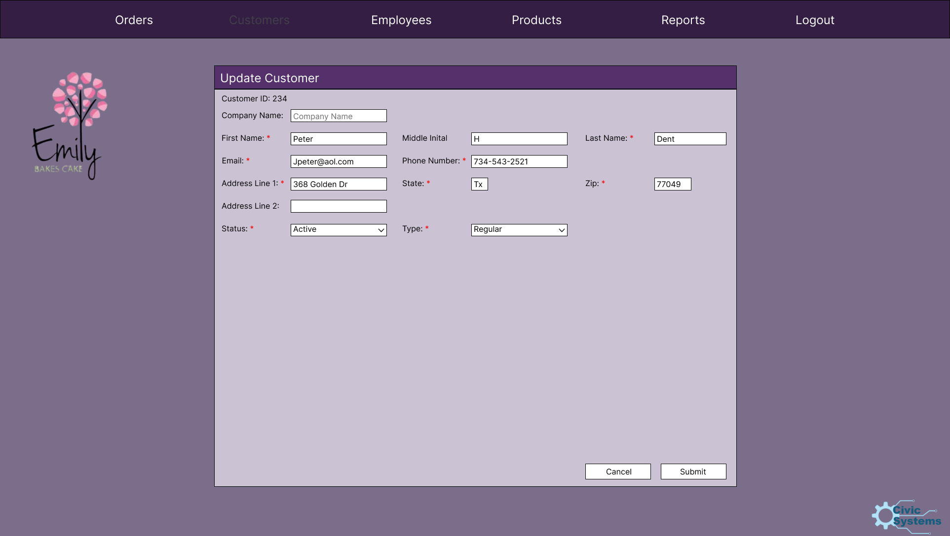

Slide 36
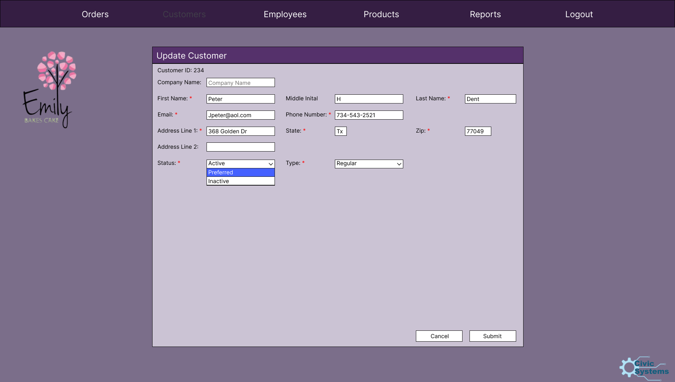

Slide 37


Slide 38
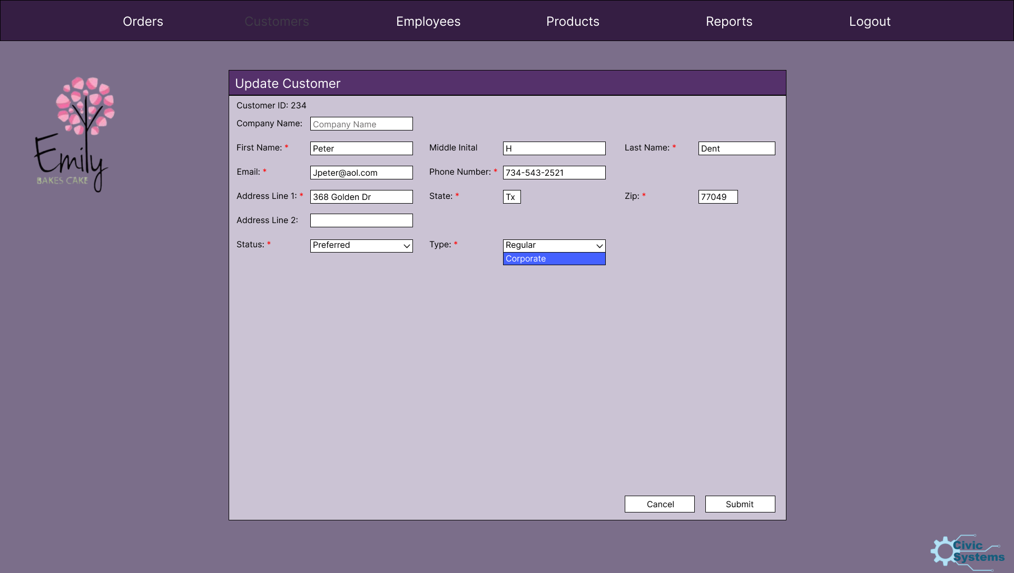

Slide 39


Slide 40
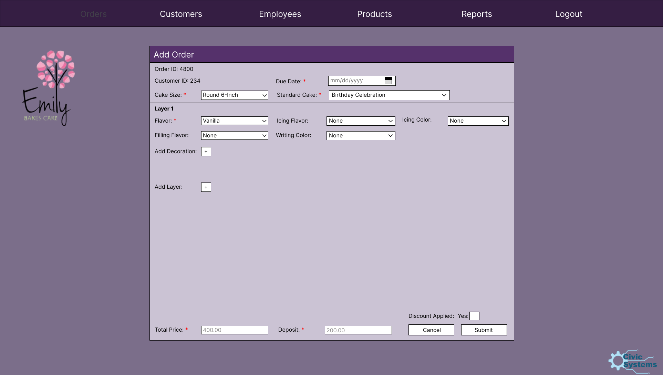

Slide 41
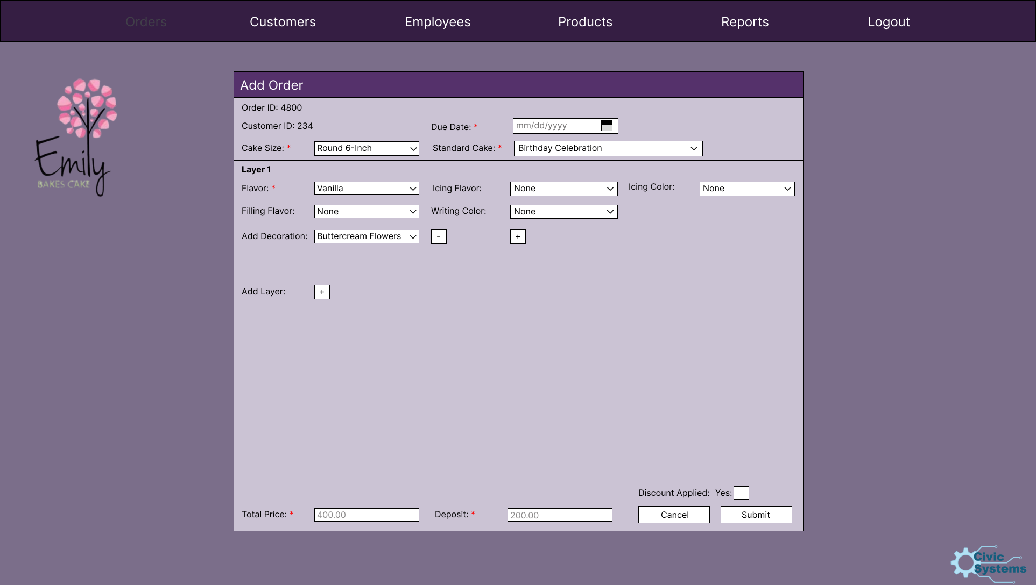

Slide 42


Slide 43
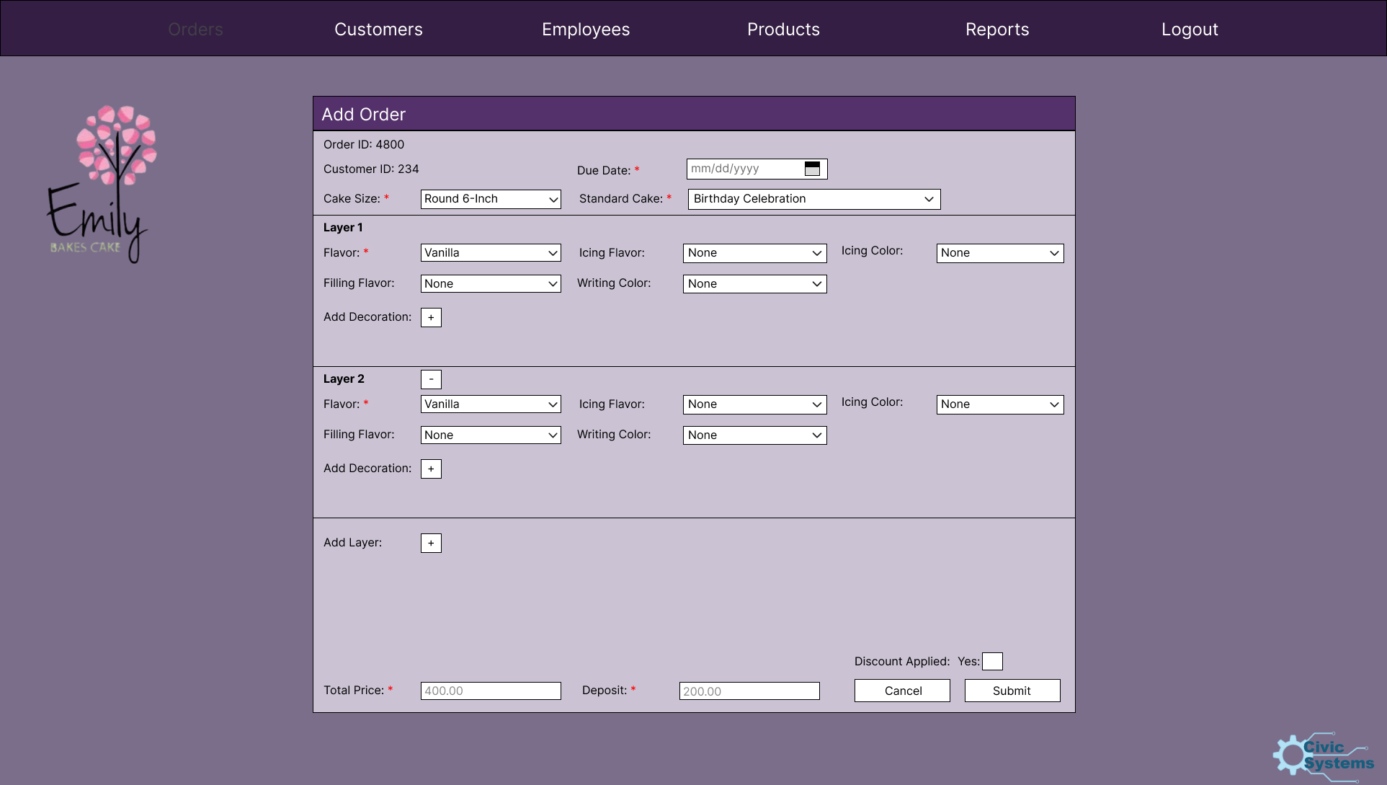

Slide 44
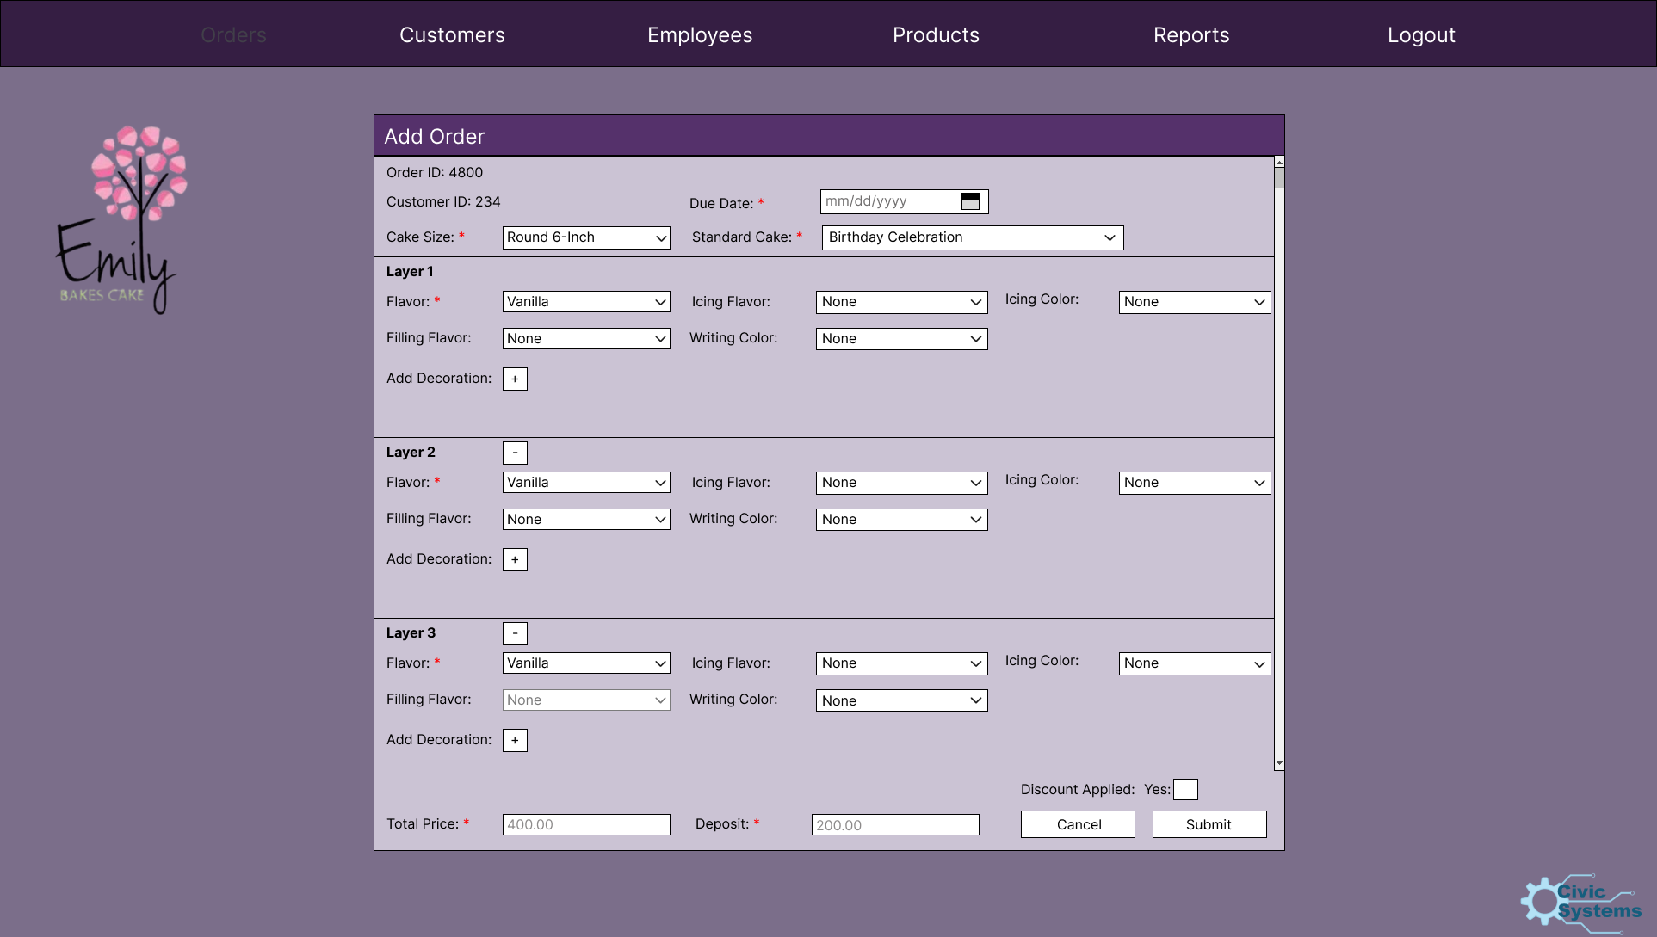

Slide 45
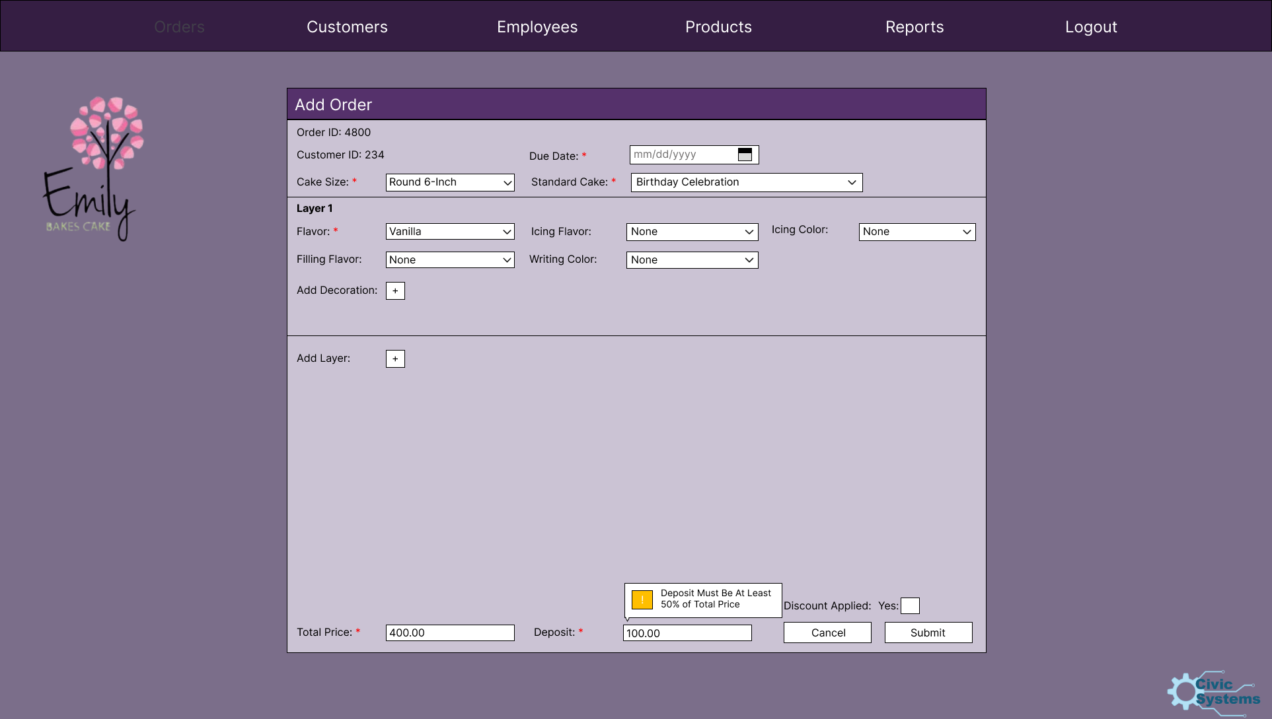

Slide 46
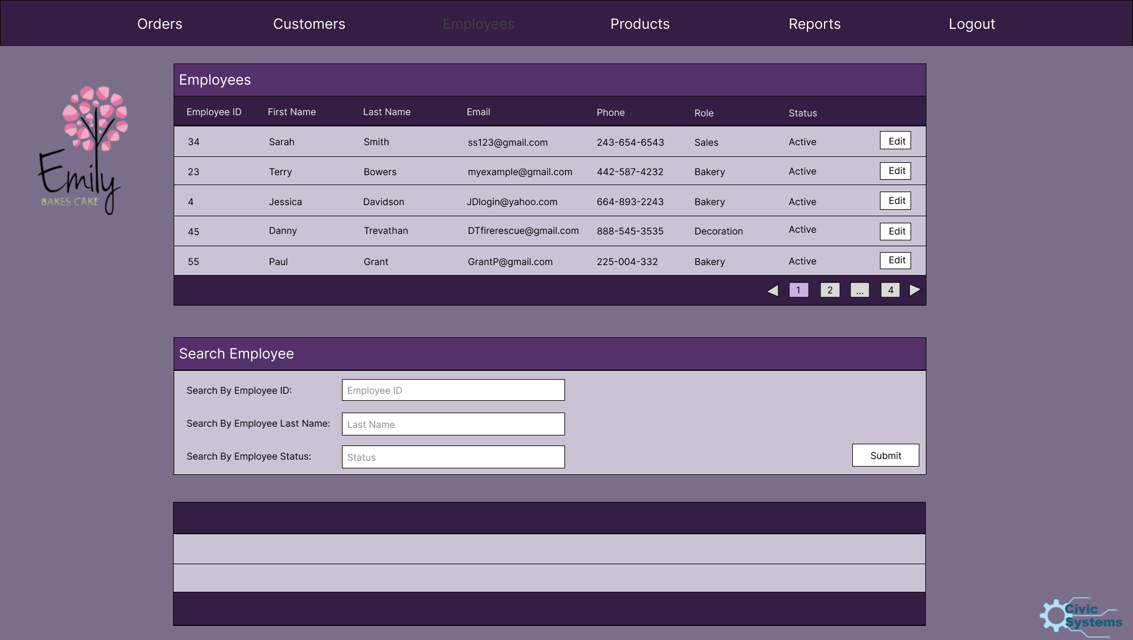

Slide 47
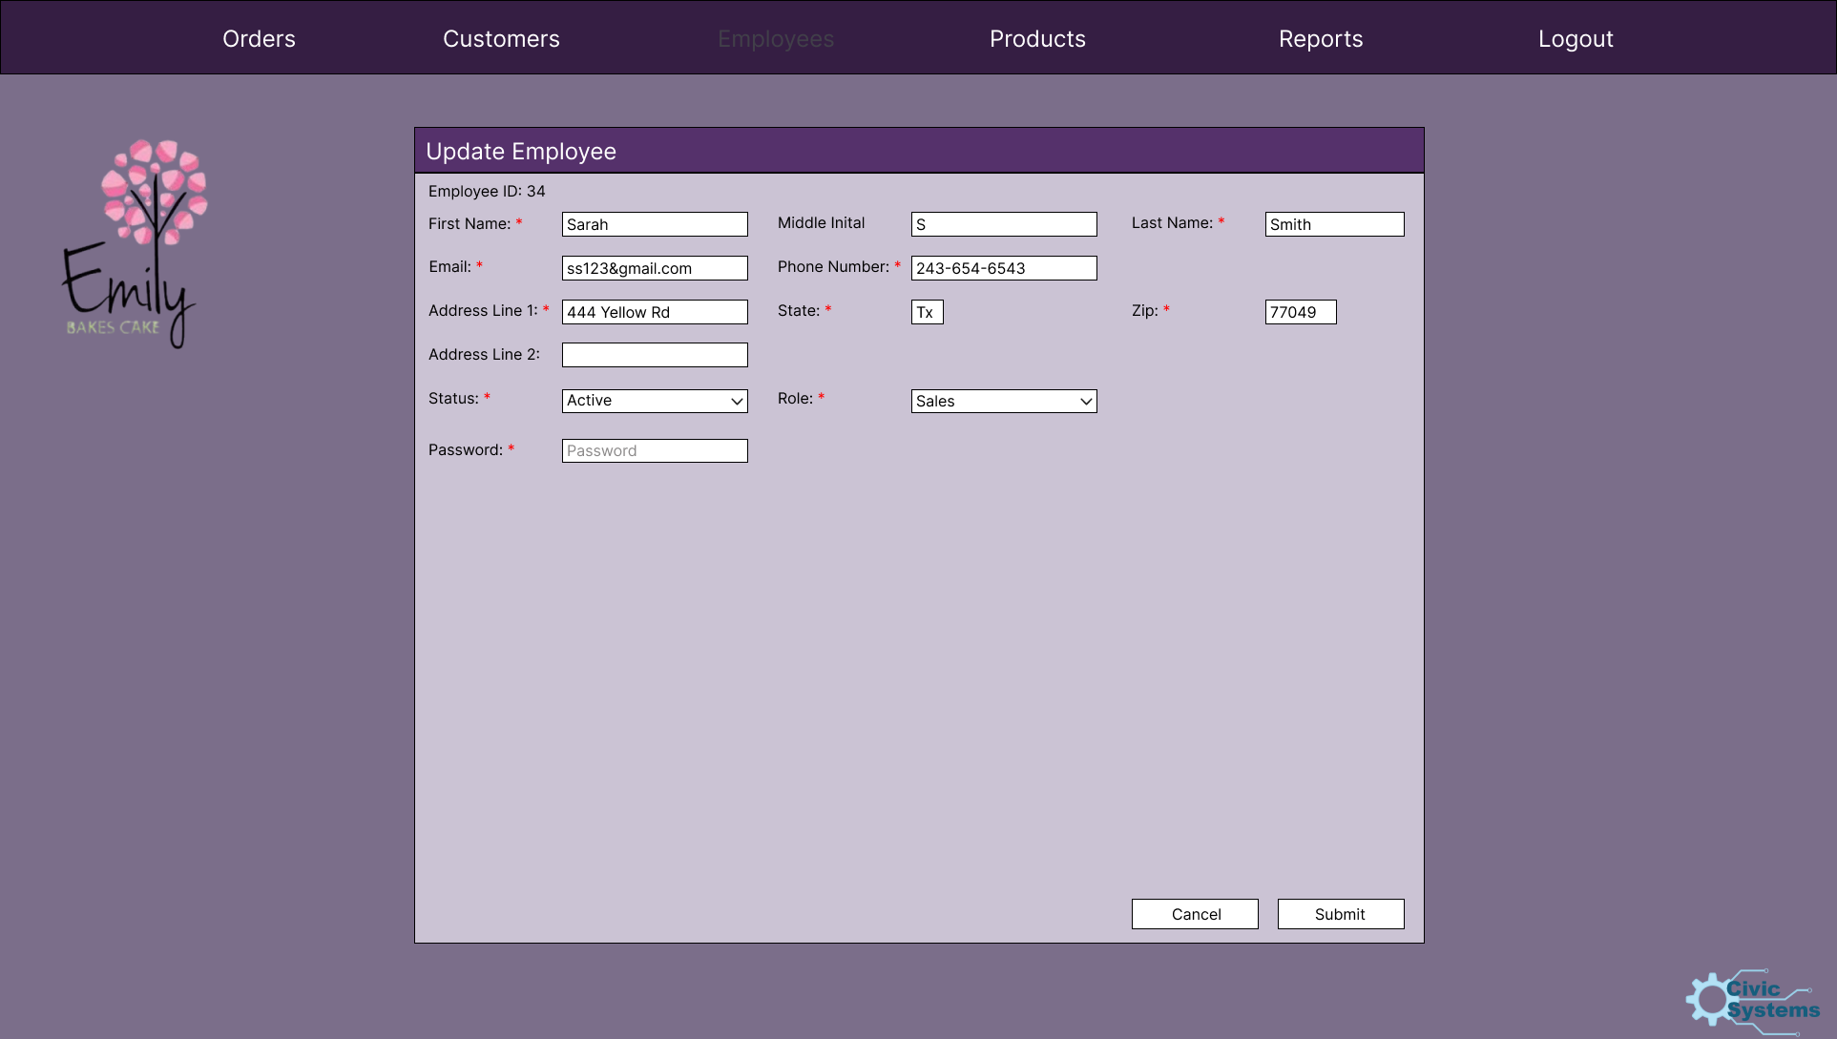

Slide 48
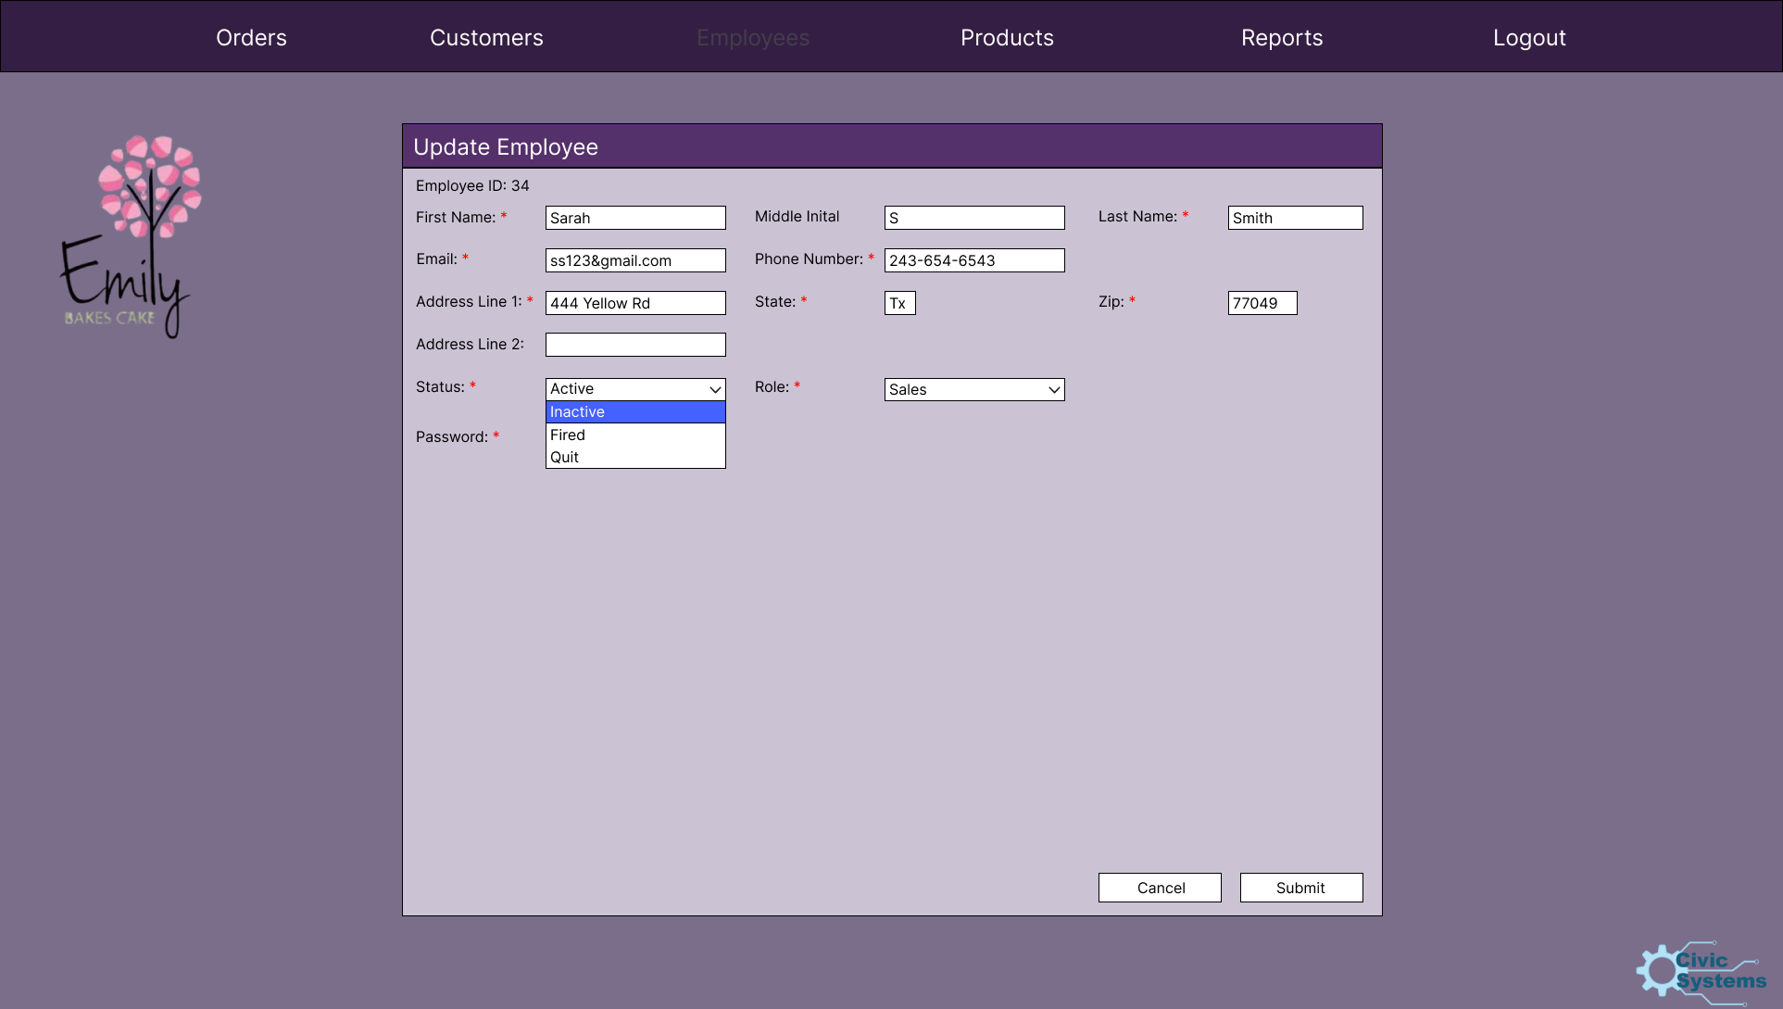

Slide 49
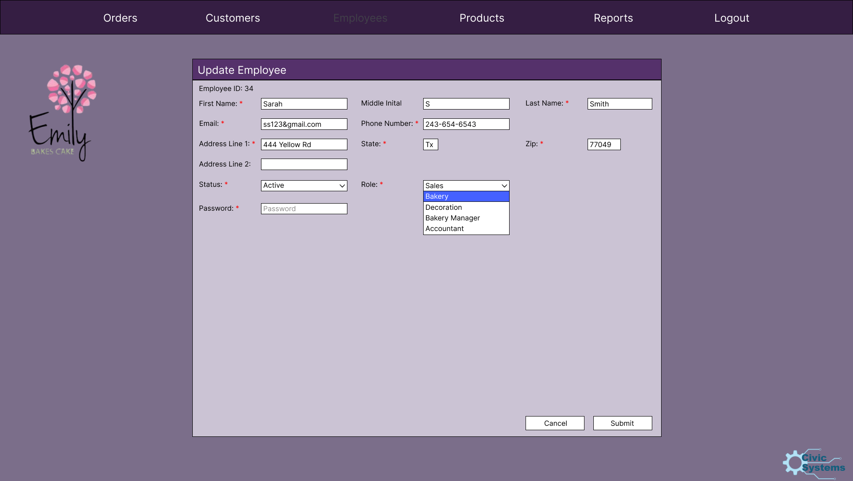

Slide 50
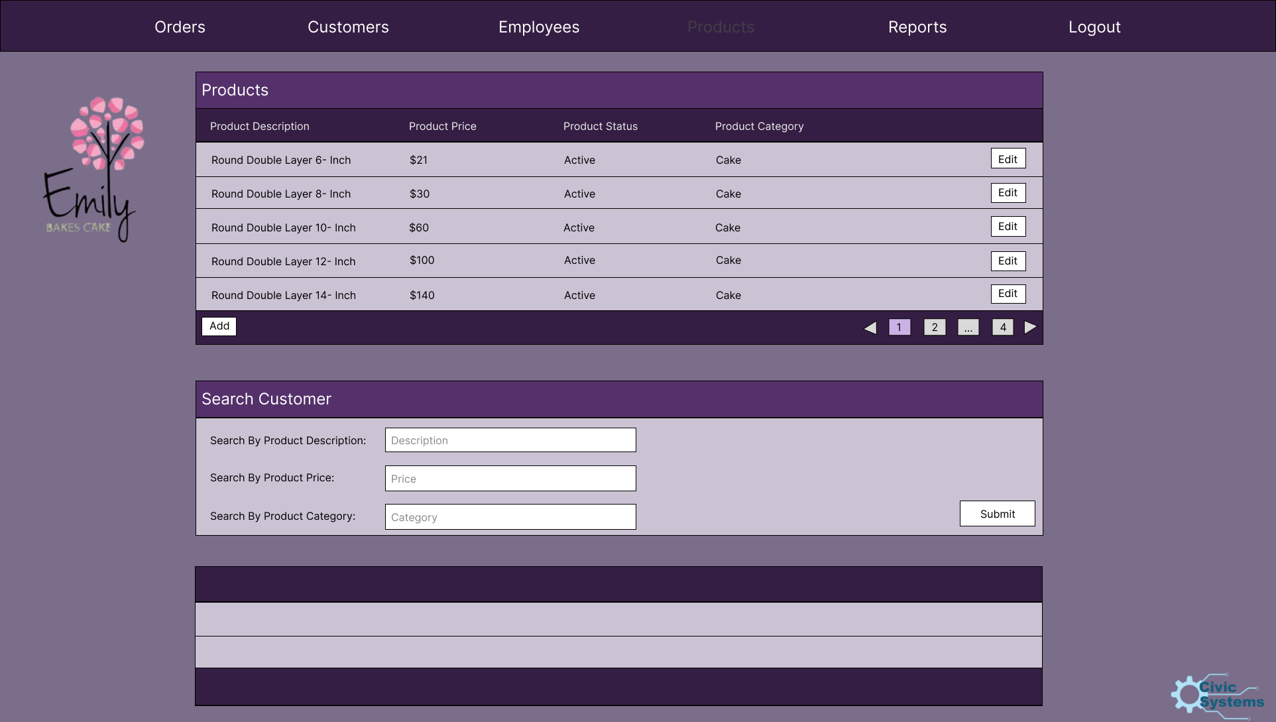

Slide 51
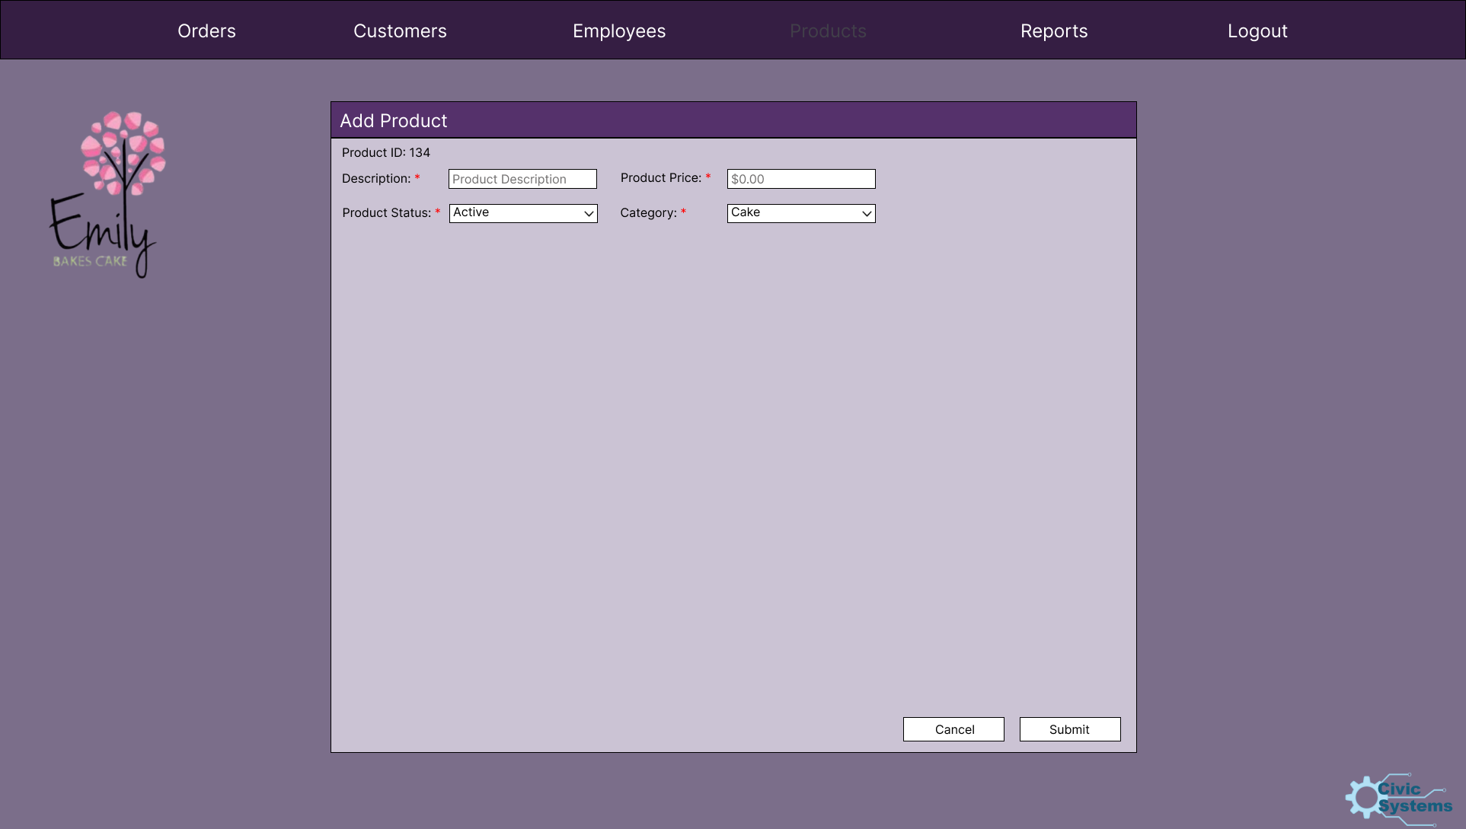

Slide 52
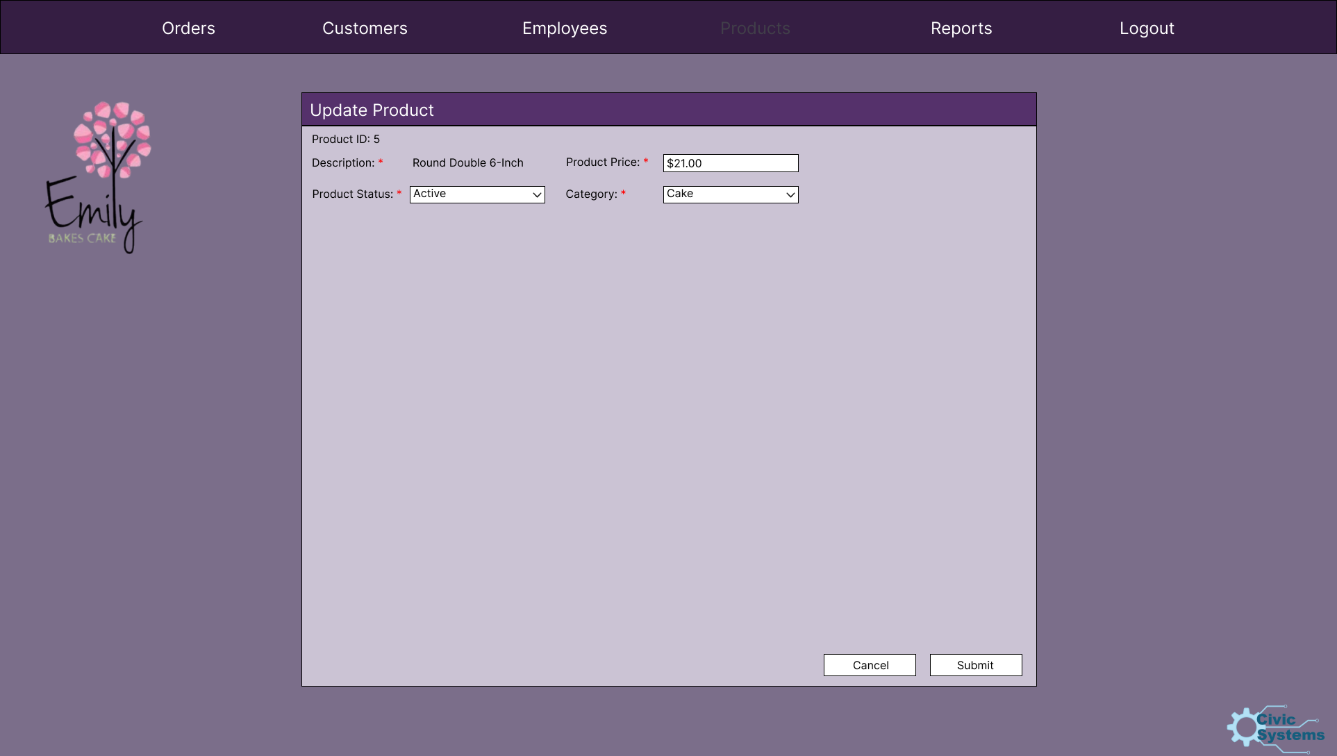

Slide 53
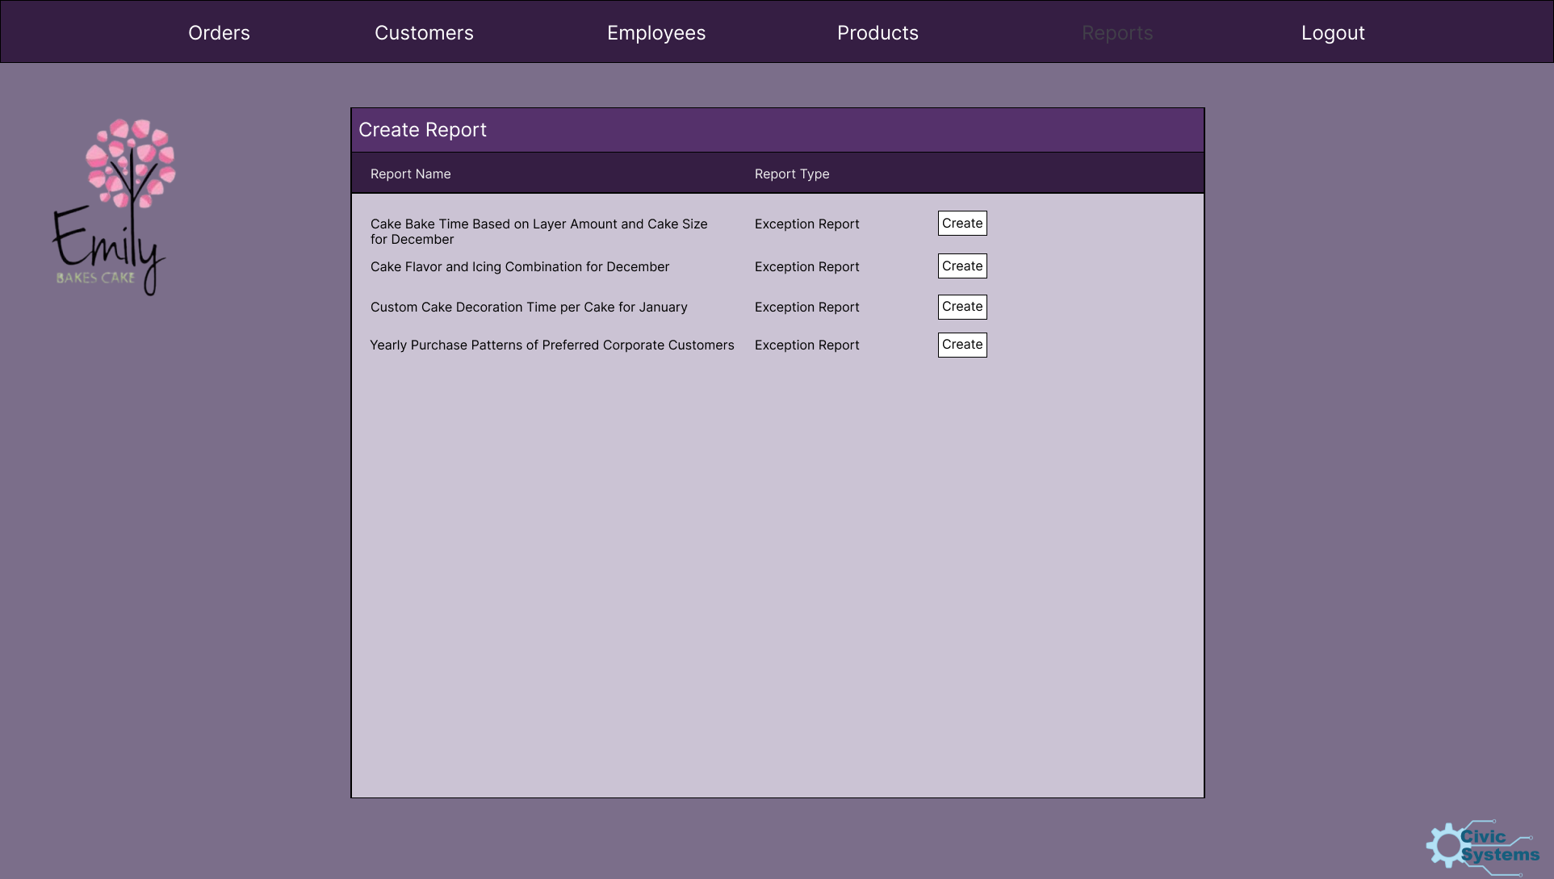

Slide 54
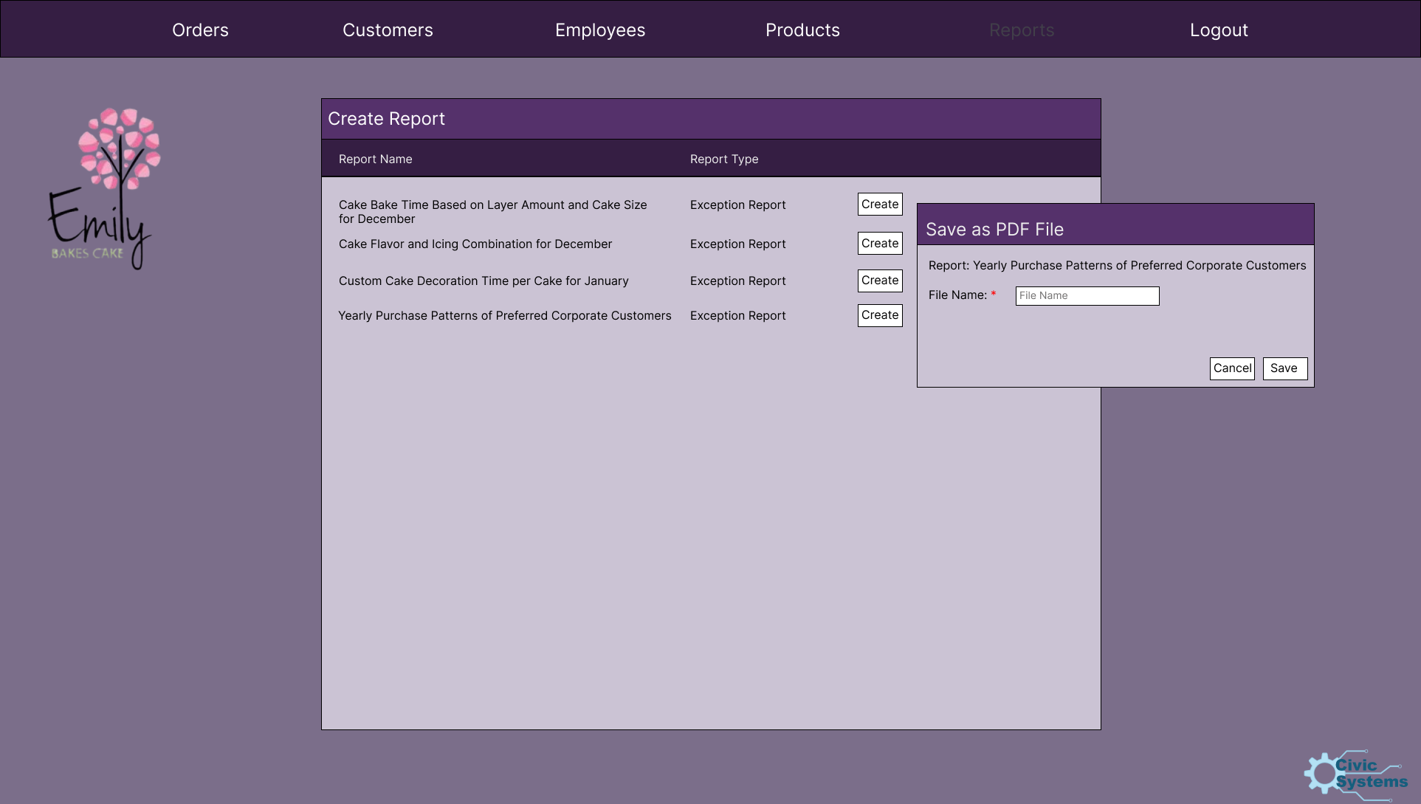

Slide 55
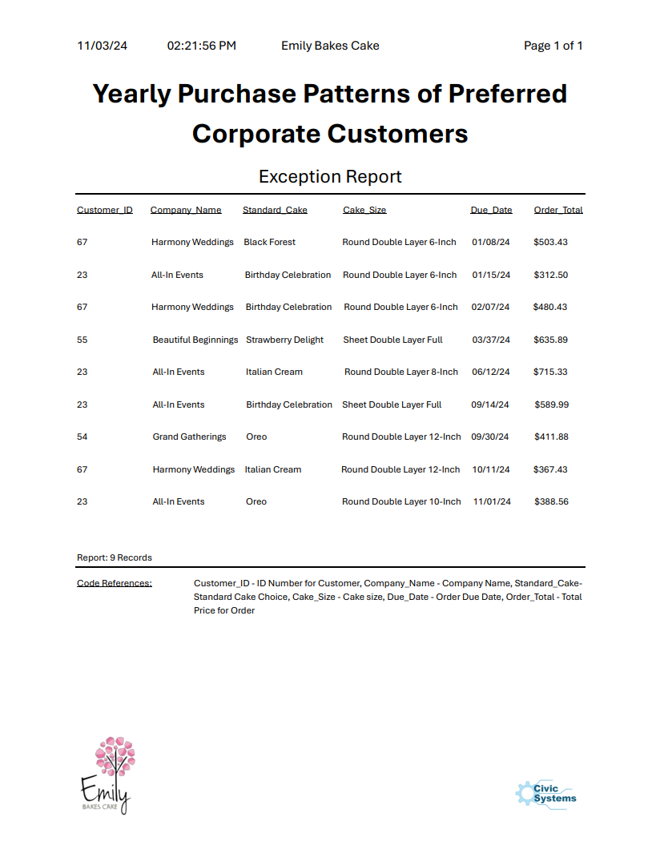

Slide 56
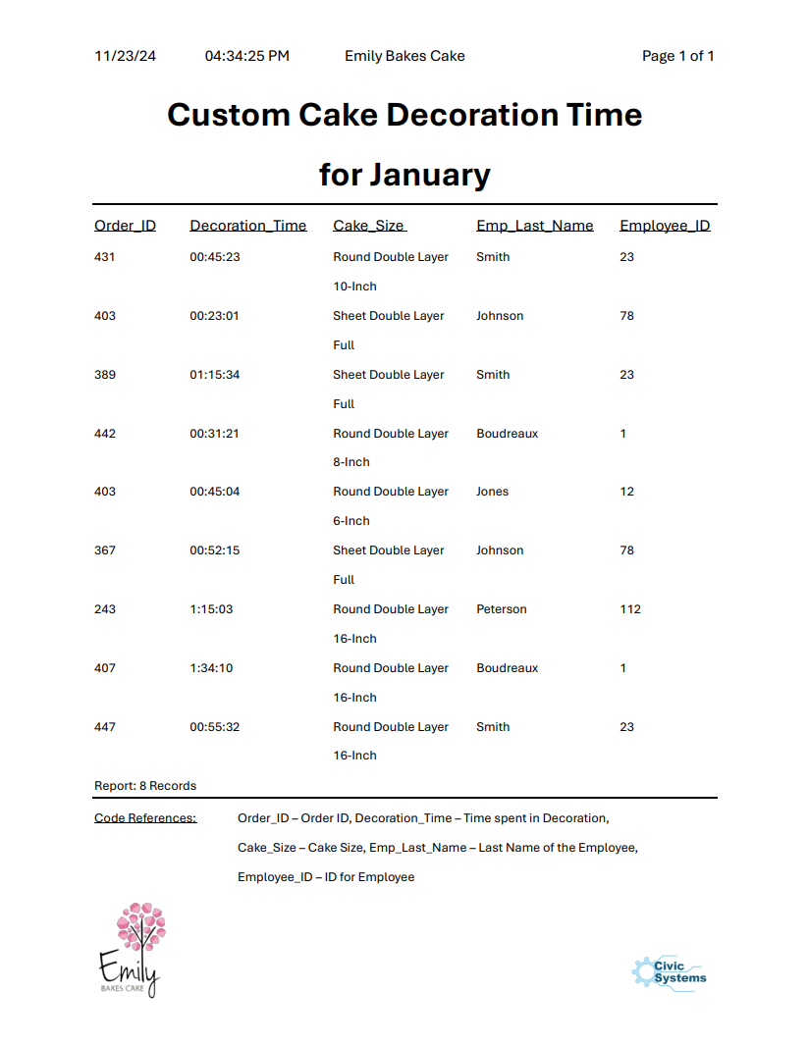

Slide 57

Questions? Comments? Concerns?

Slide 58

Lessons Learned: What Worked
Leveraging communication and filesharing software and websites like Discord and Github
Having more than one person specialize in applications such as MS Project and Vizio
Role-Responsibilities Matrix greatly helped us organize and divide the work
ThePhoto by PhotoAuthor is licensed under CCYYSA.

Slide 59

Lessons Learned: What Didn't Work
Lack of consistent communication
Lack of step-by-step collaboration
Scheduling for team meetups

Slide 60
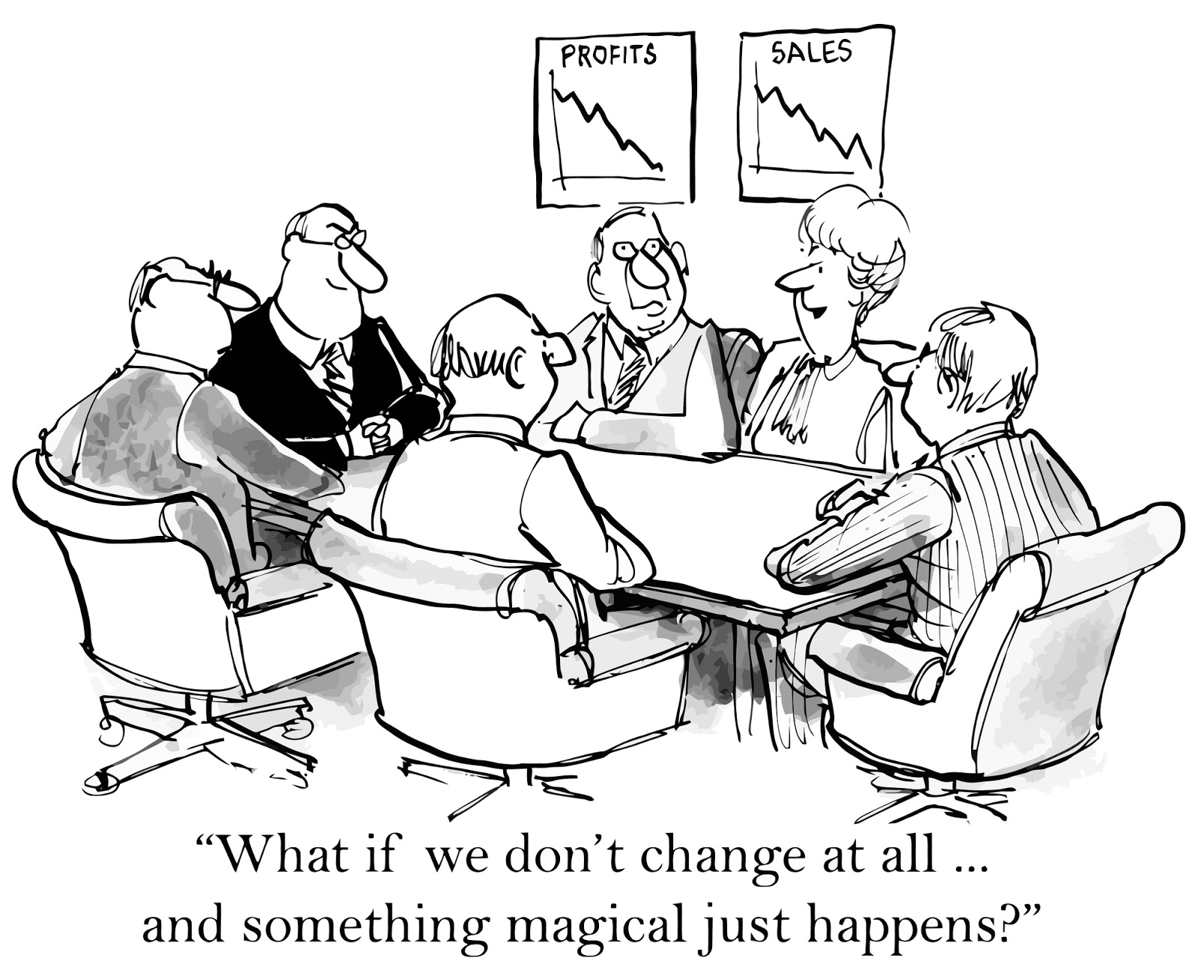
Lessons Learned: What We Could've Differently
Hold a more consistent weekly meeting schedule.
Build a more detailed questionnaire to business owner.
Come up with a better work system to identify any delayed or unworked deliverables, as we had a member drop the class late in the semester
ThePhoto by PhotoAuthor is licensed under CCYYSA.

